Slide 1
Remake Barplot

Slide 2
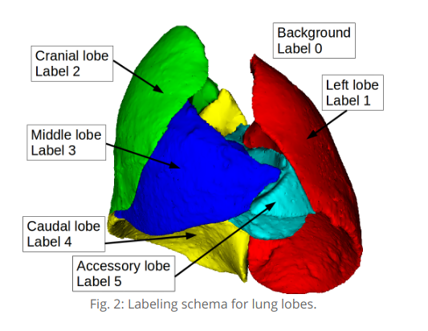

Slide 3
Strain B6C3F1
Name | Strain | Gender | Weight | Particle_Size
m02 | B6C3F1 | F | 19.5 | 1
m06 | B6C3F1 | F | 21 | 1
m01 | B6C3F1 | M | N/A | 1
m11 | B6C3F1 | M | 23.4 | 1

Slide 4
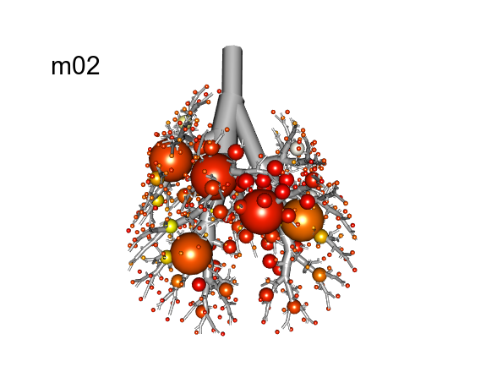
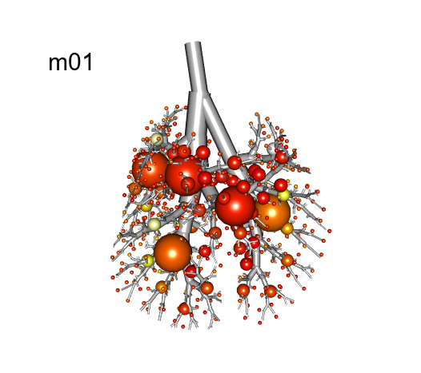
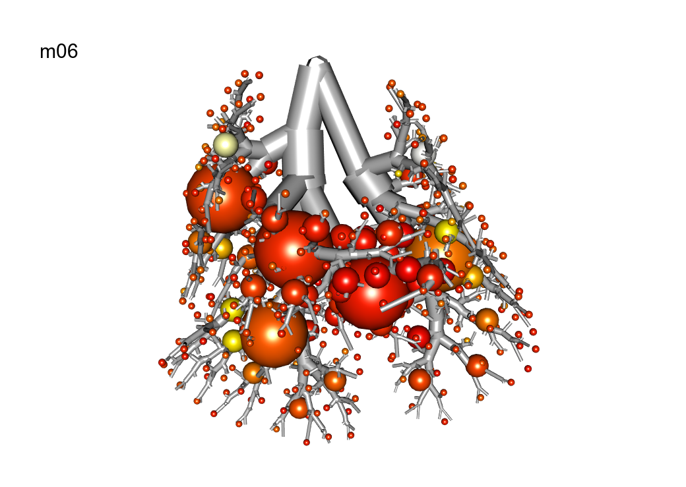
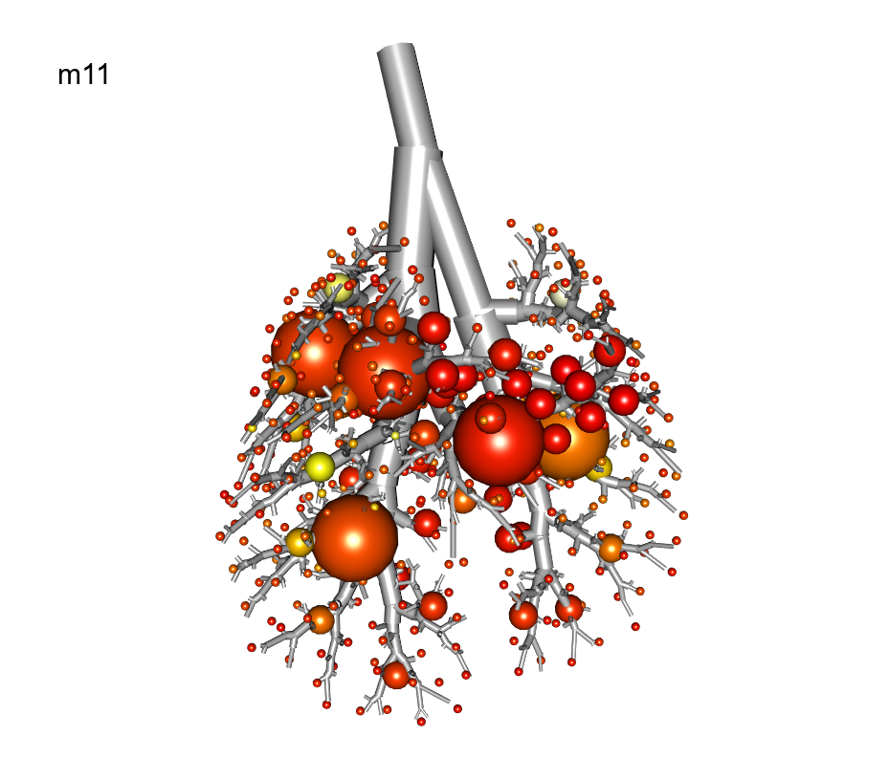

Slide 5
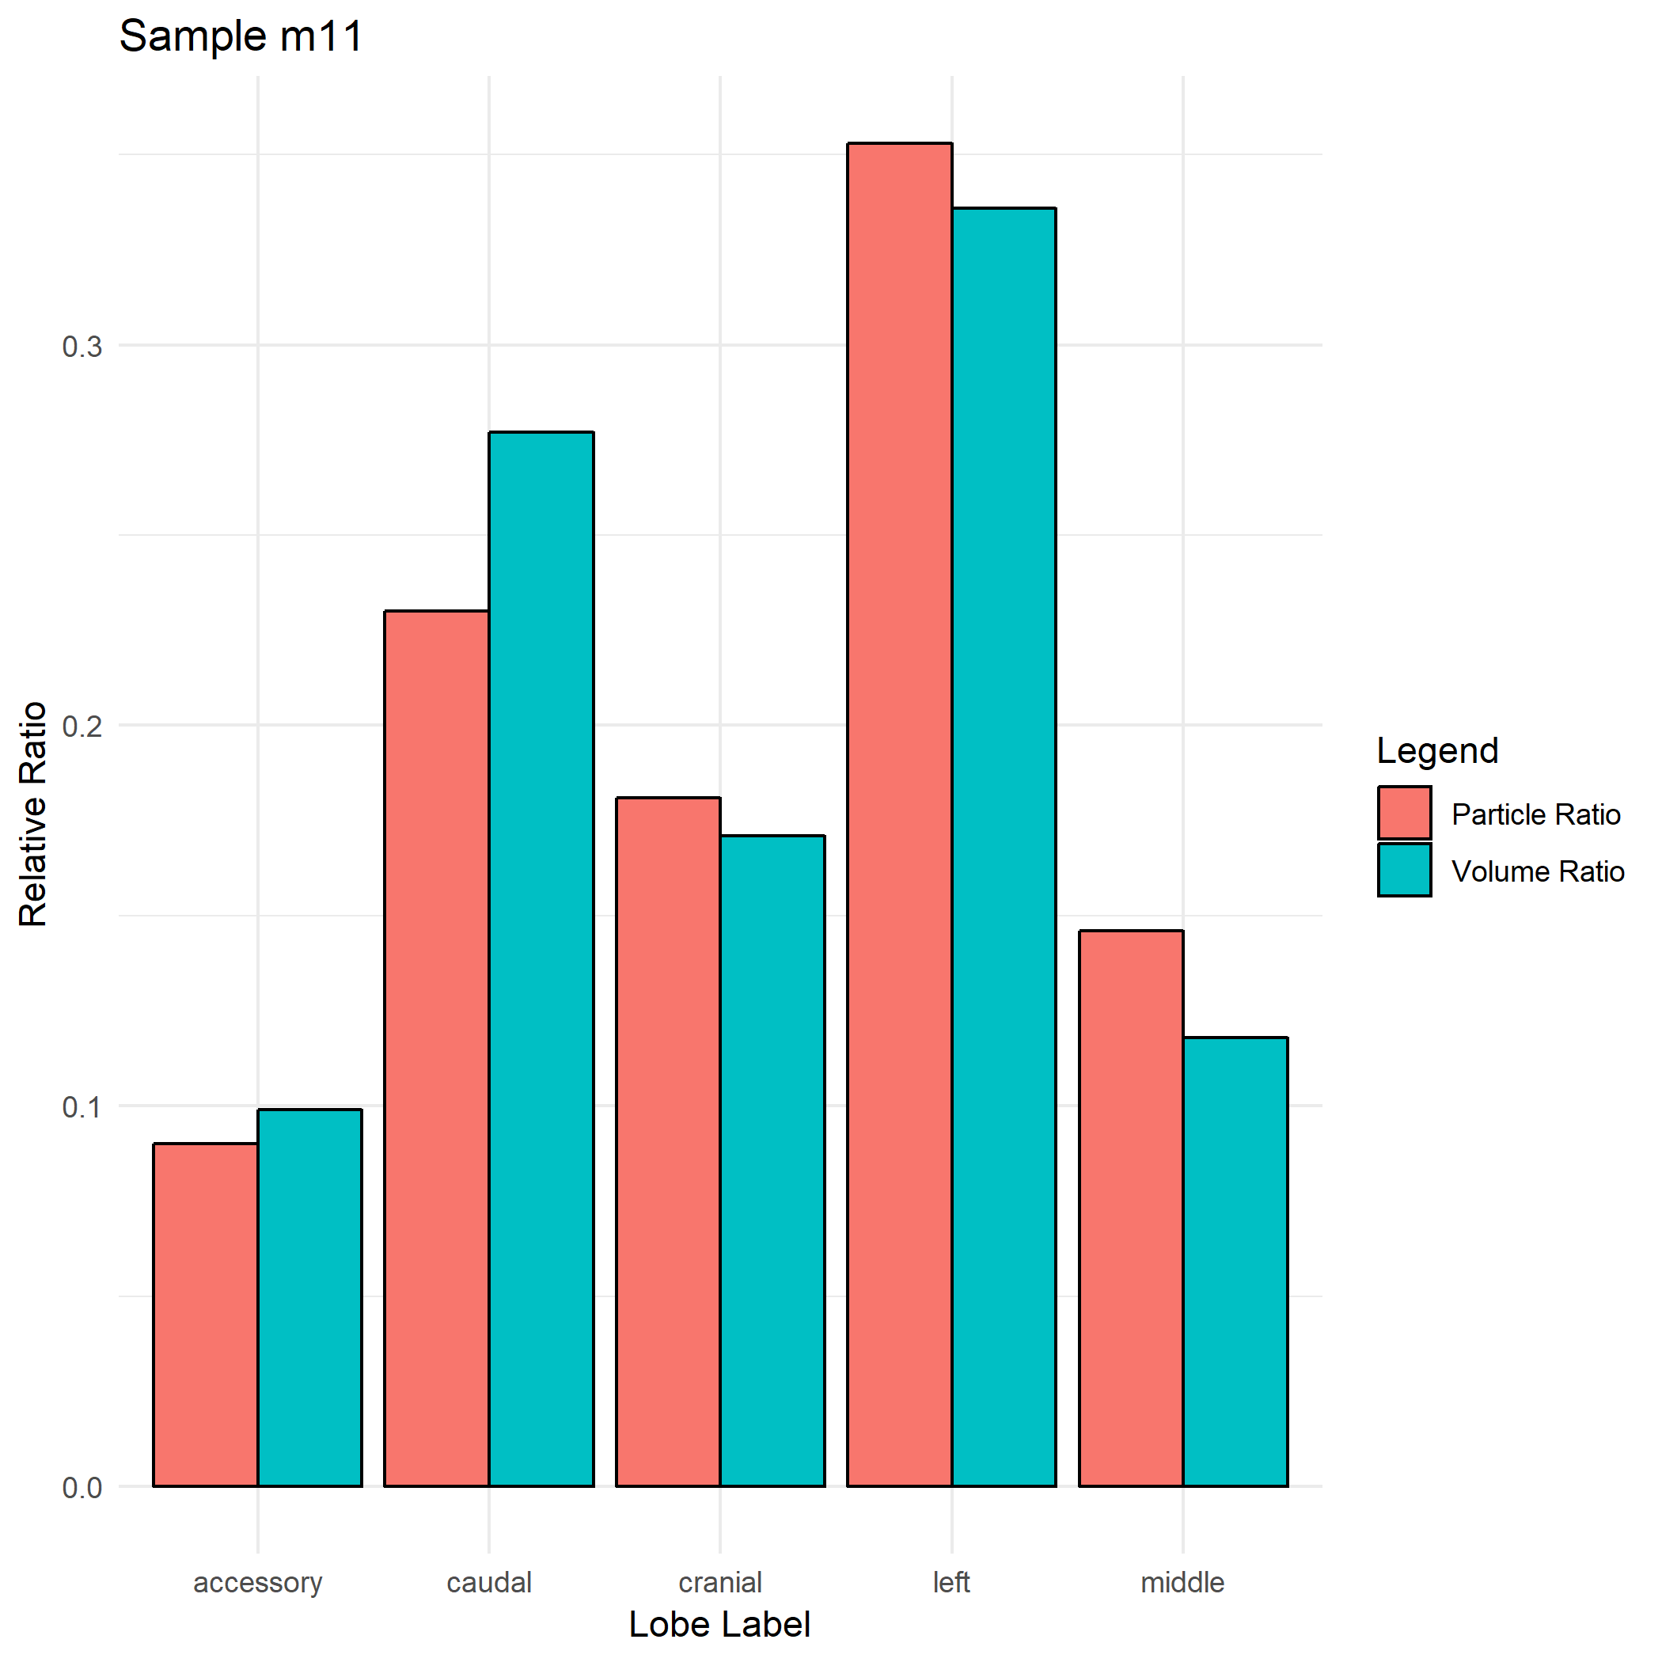
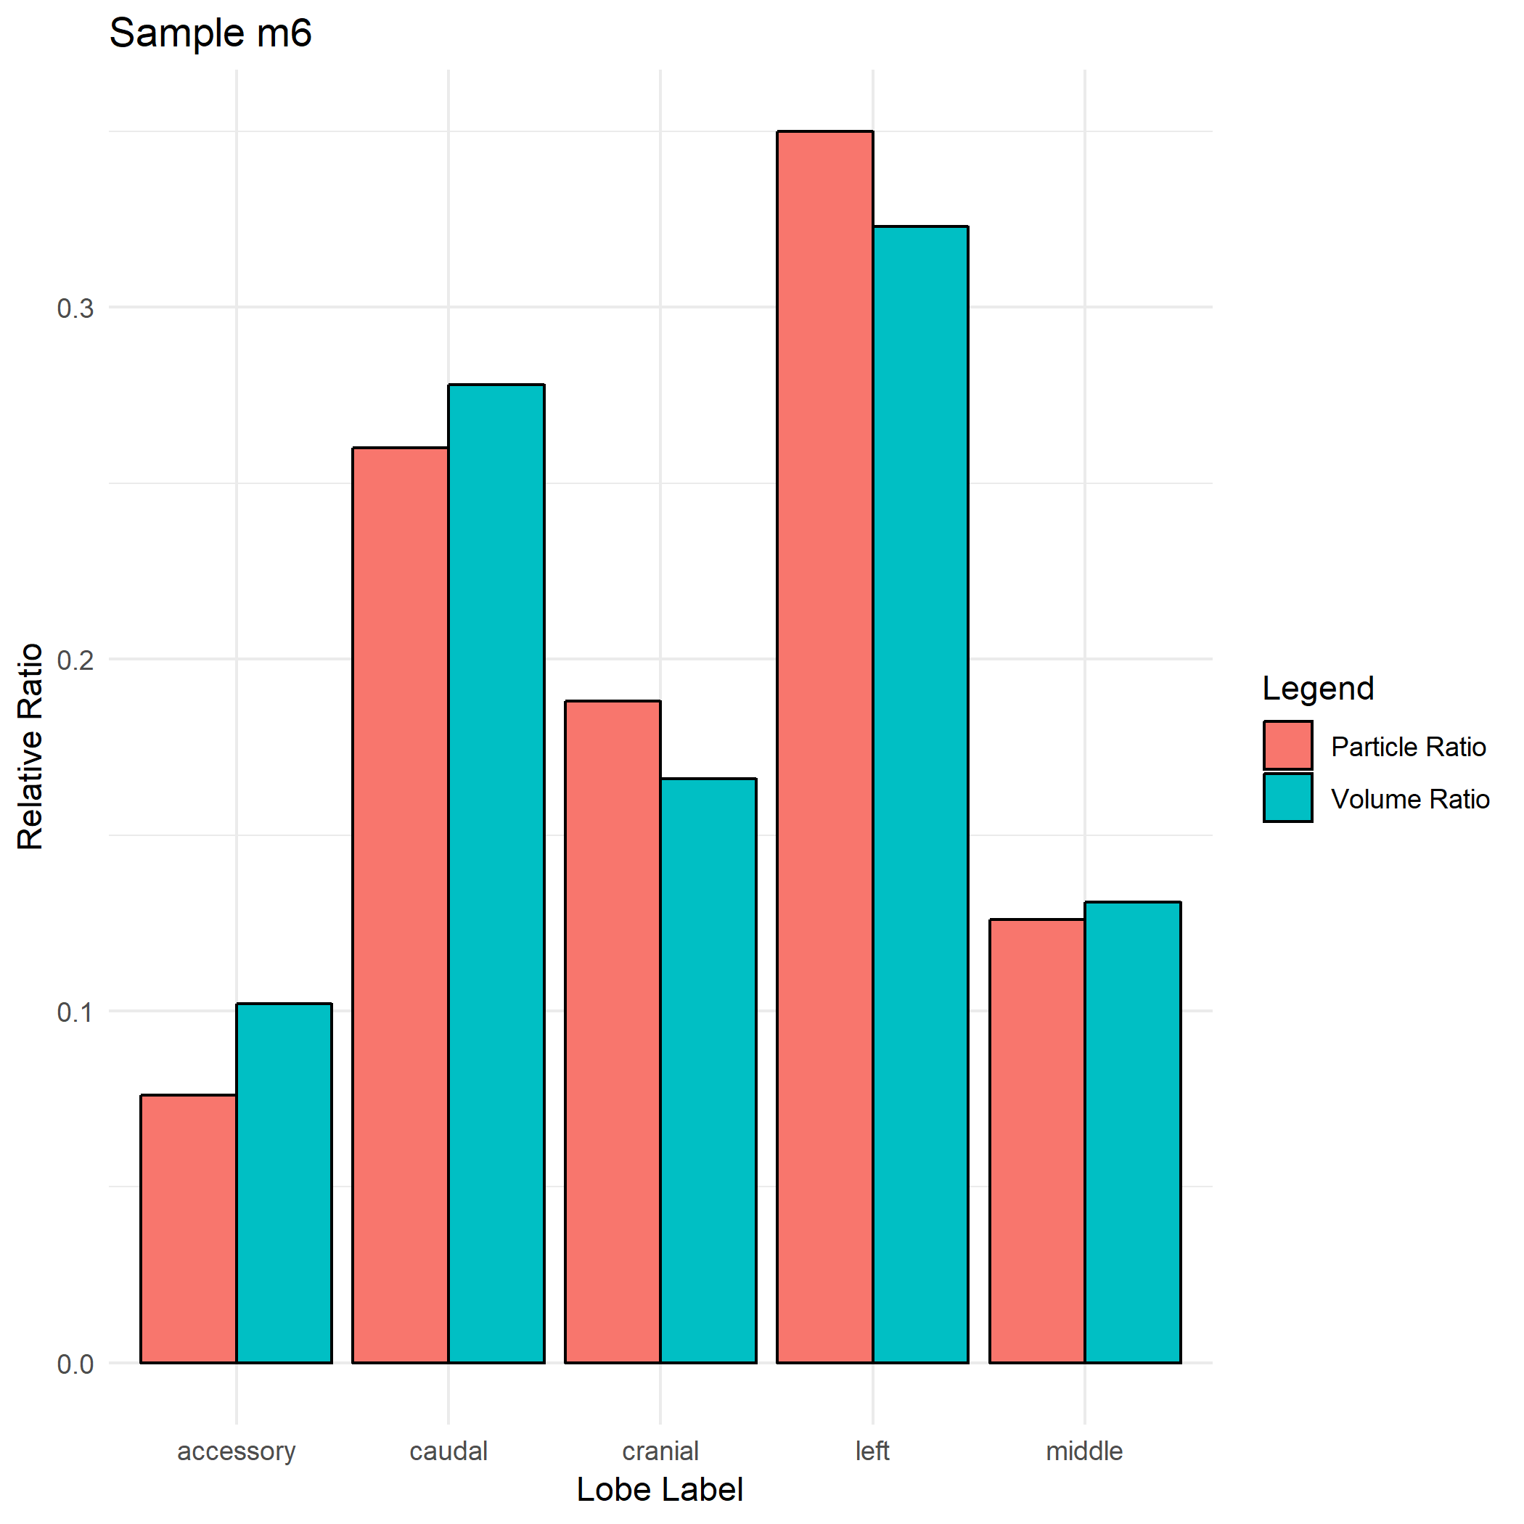
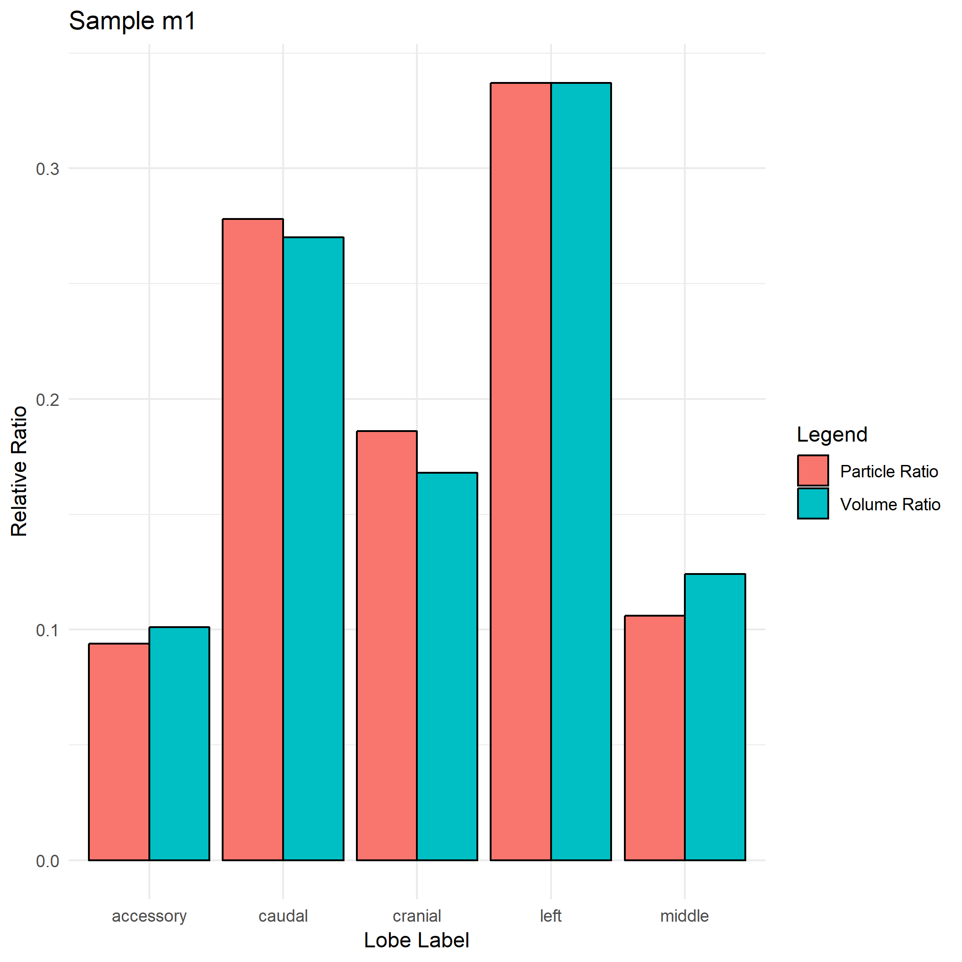
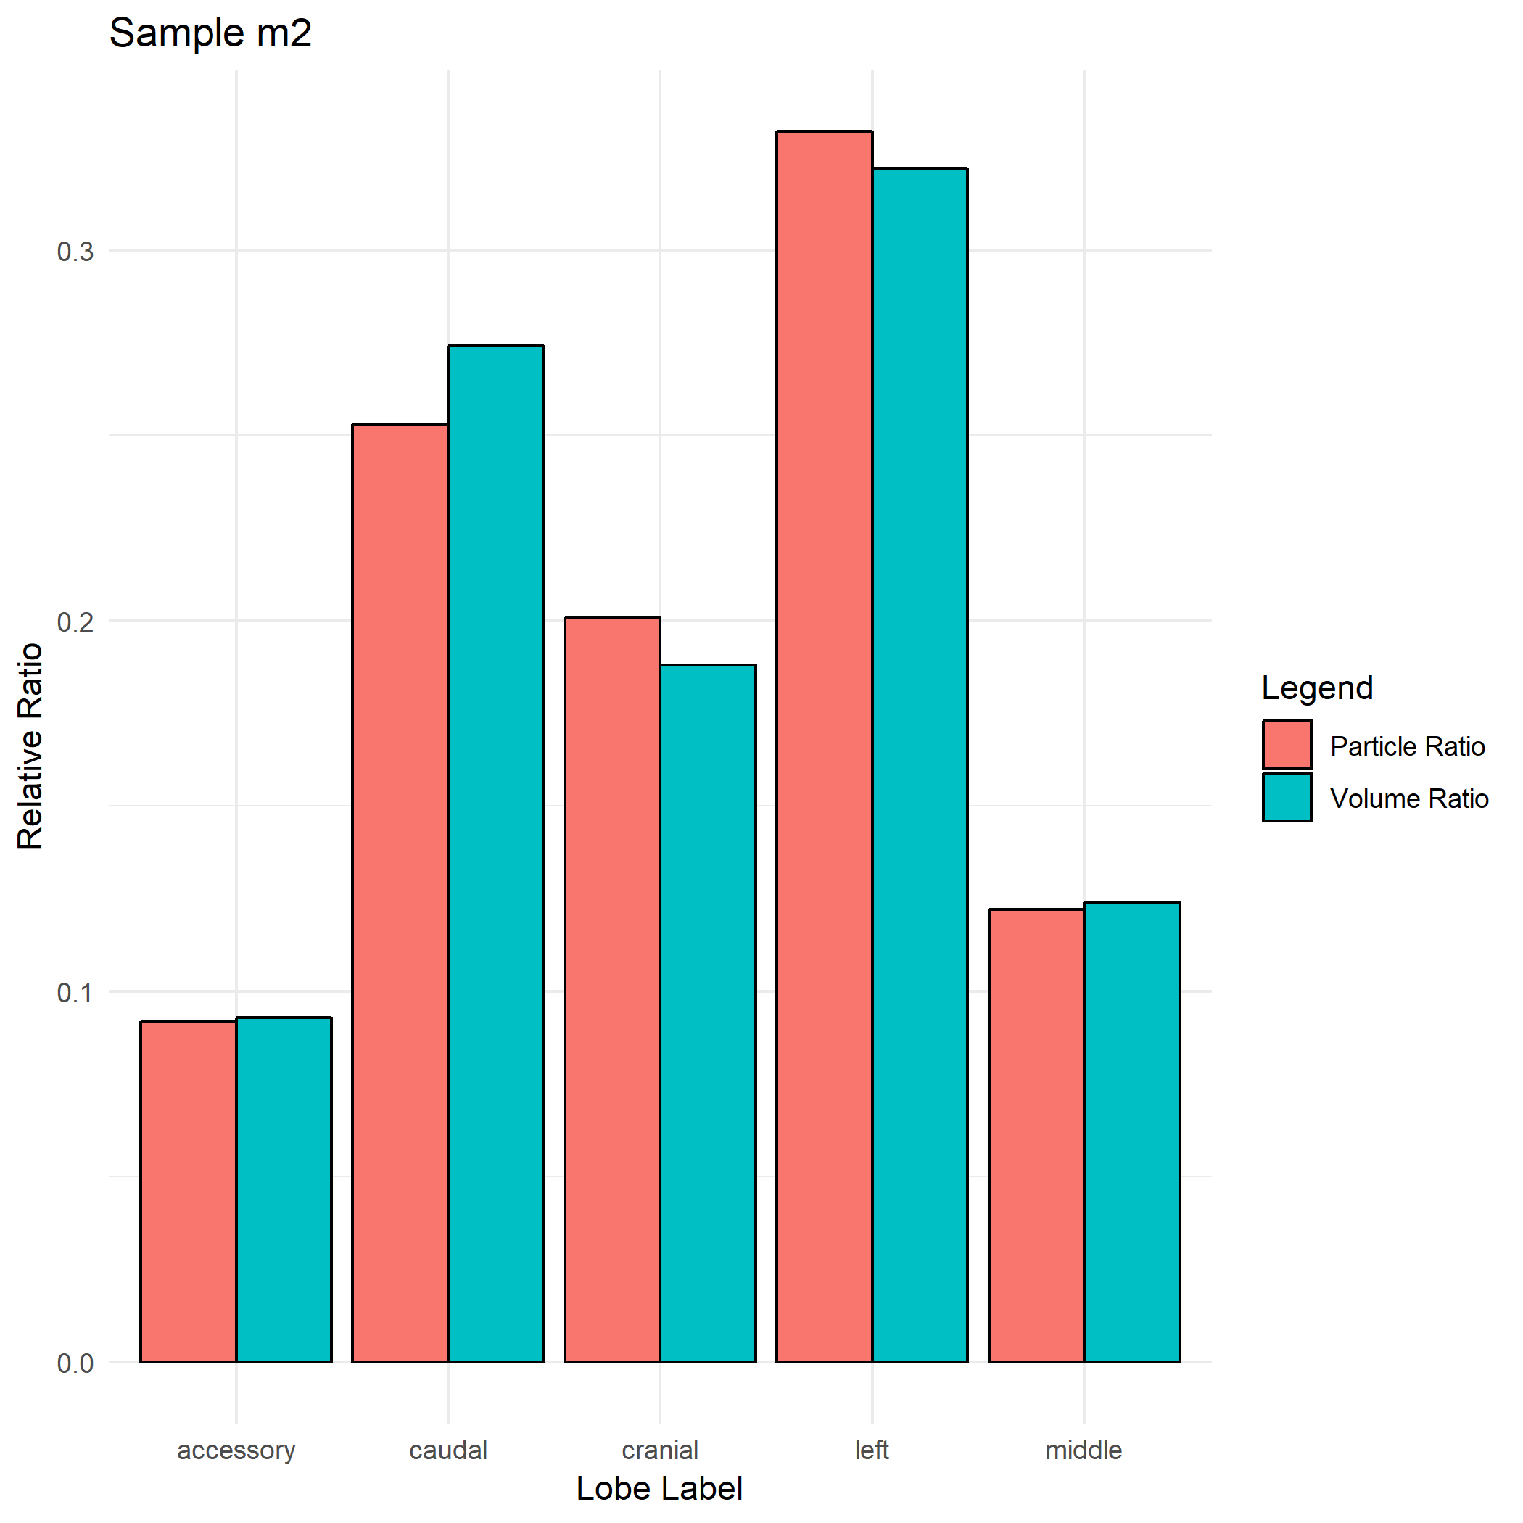

Slide 6
Strain BALB/C
Name | Strain | Gender | Weight | Particle_Size
m09 | BALB/c | F | 23.7 | 1
m10 | BALB/c | F | N/A | 1
m03 | BALB/c | M | 23.8 | 1

Slide 7
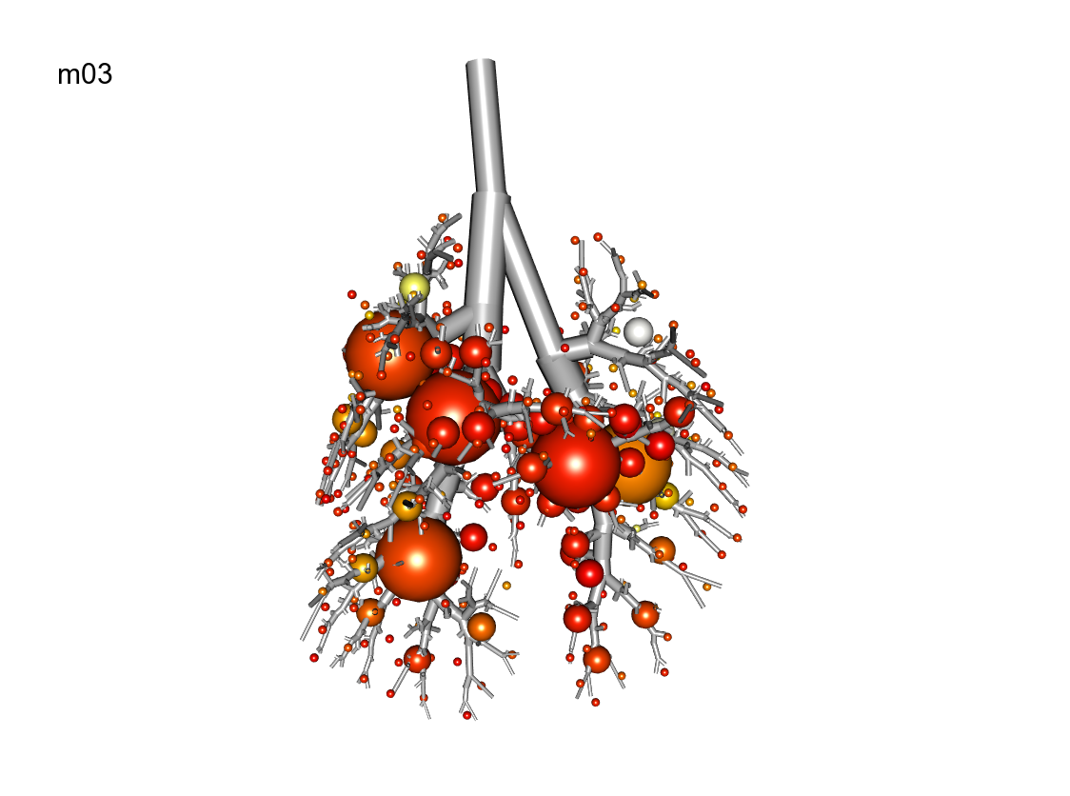
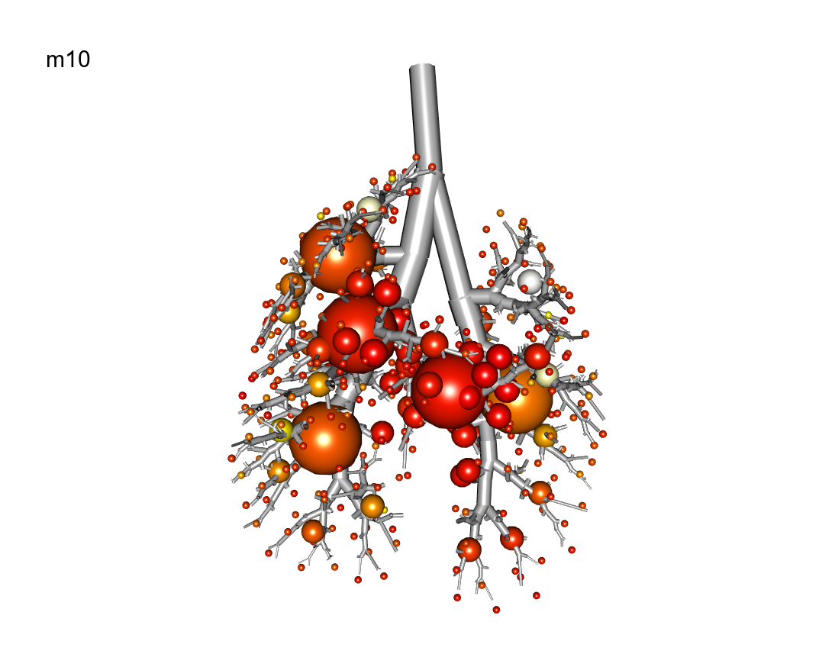
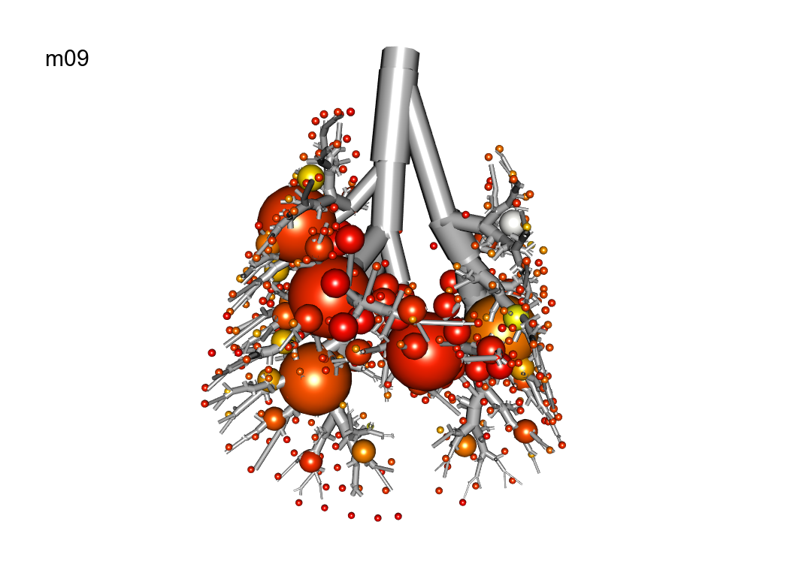

Slide 8
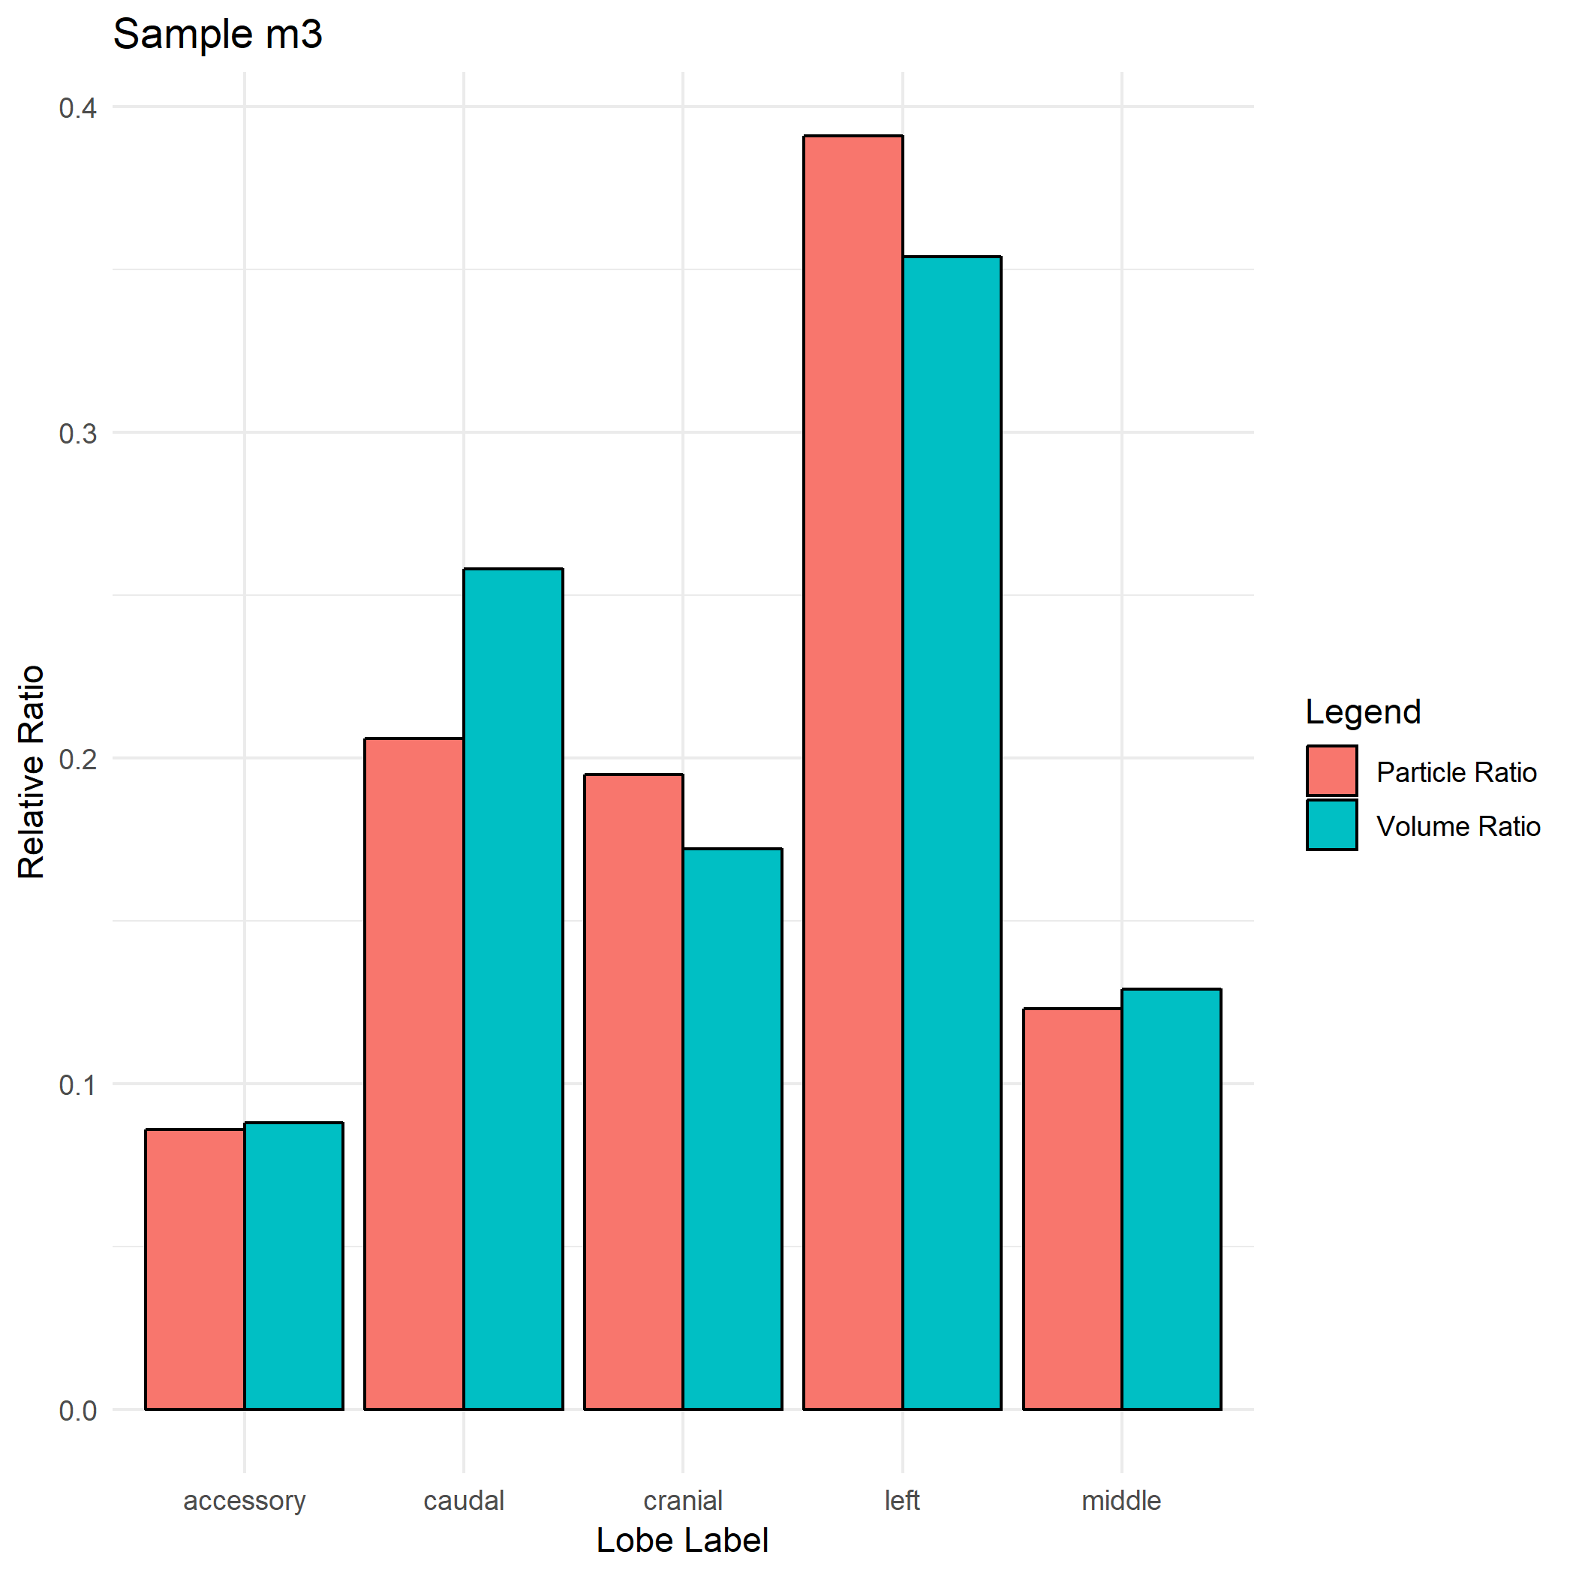
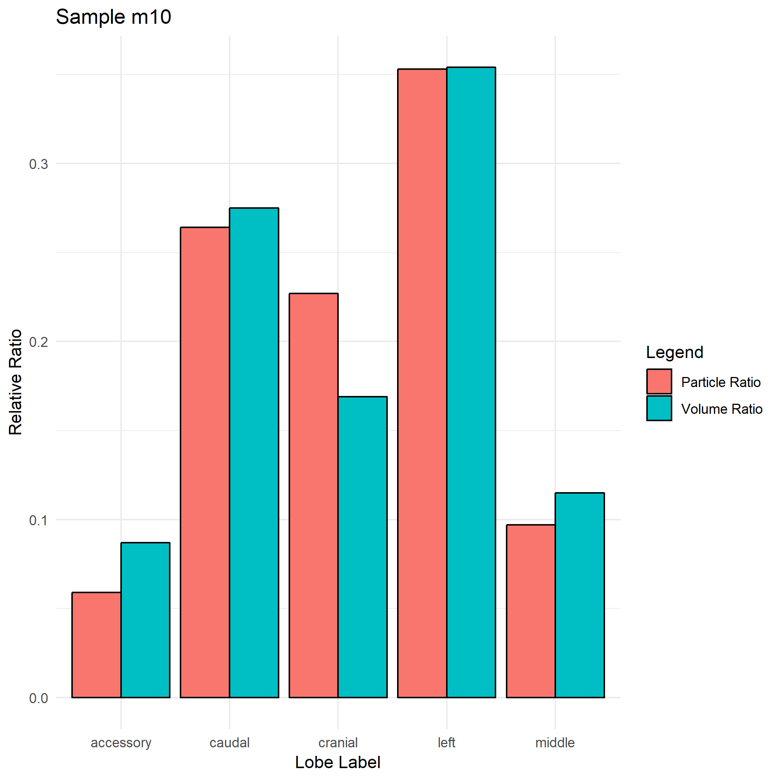
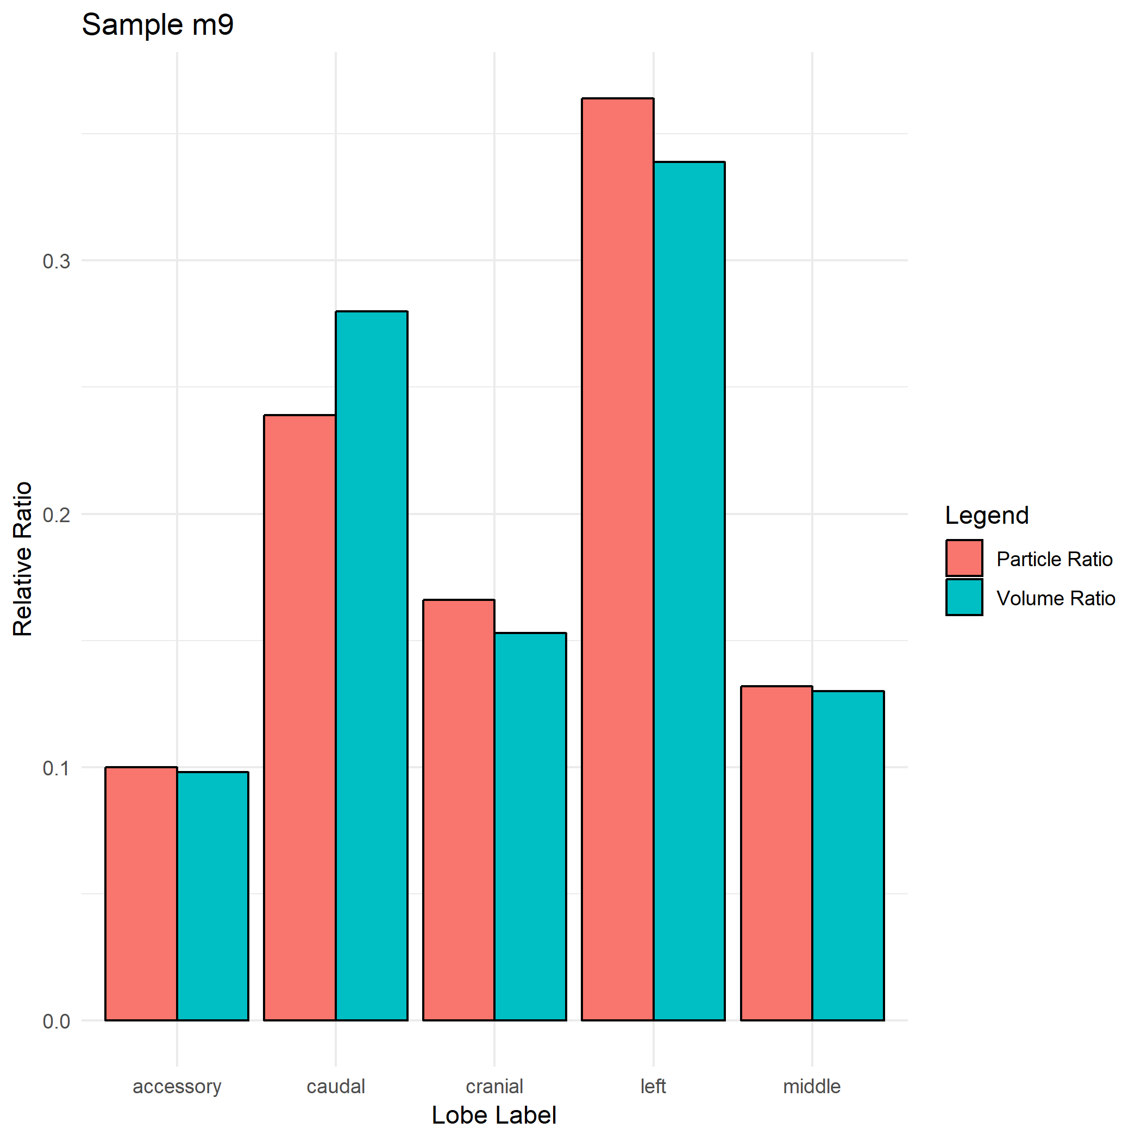

Slide 9
Strain C57BL/6
Name | Strain | Gender | Weight | Particle_Size
m08 | C57BL/6 | F | 23 | 1
m07 | C57BL/6 | M | 24.1 | 1
m14 | C57Bl/6 | M | NaN | 1

Slide 10
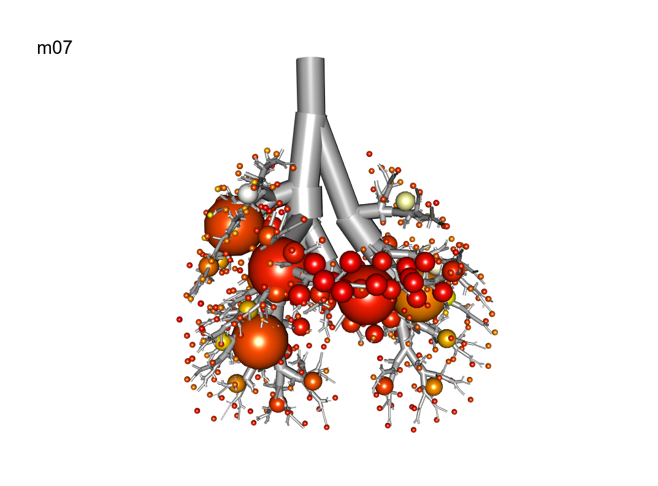
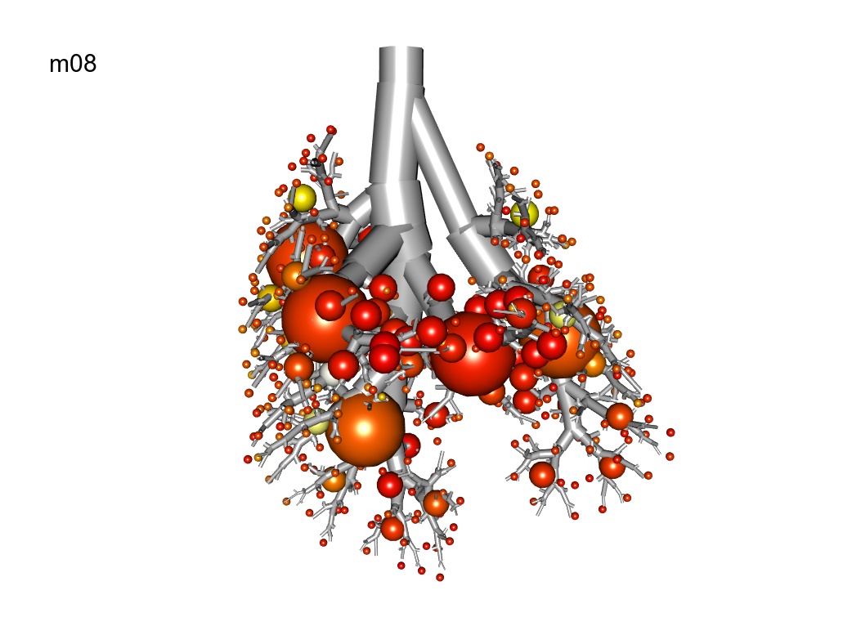
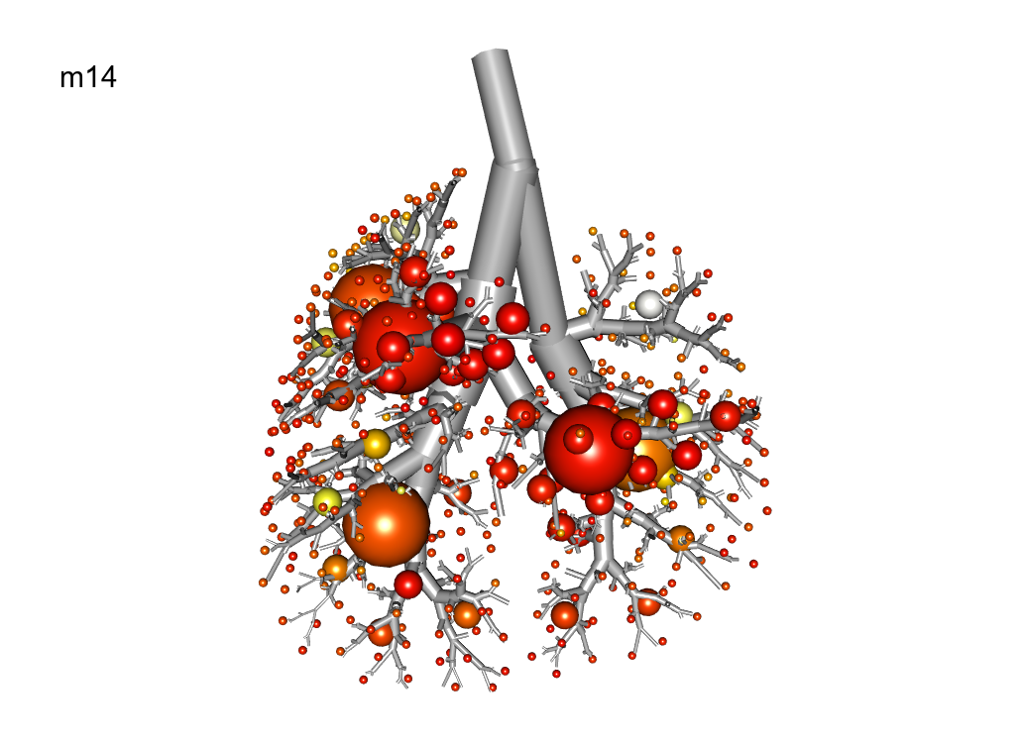

Slide 11
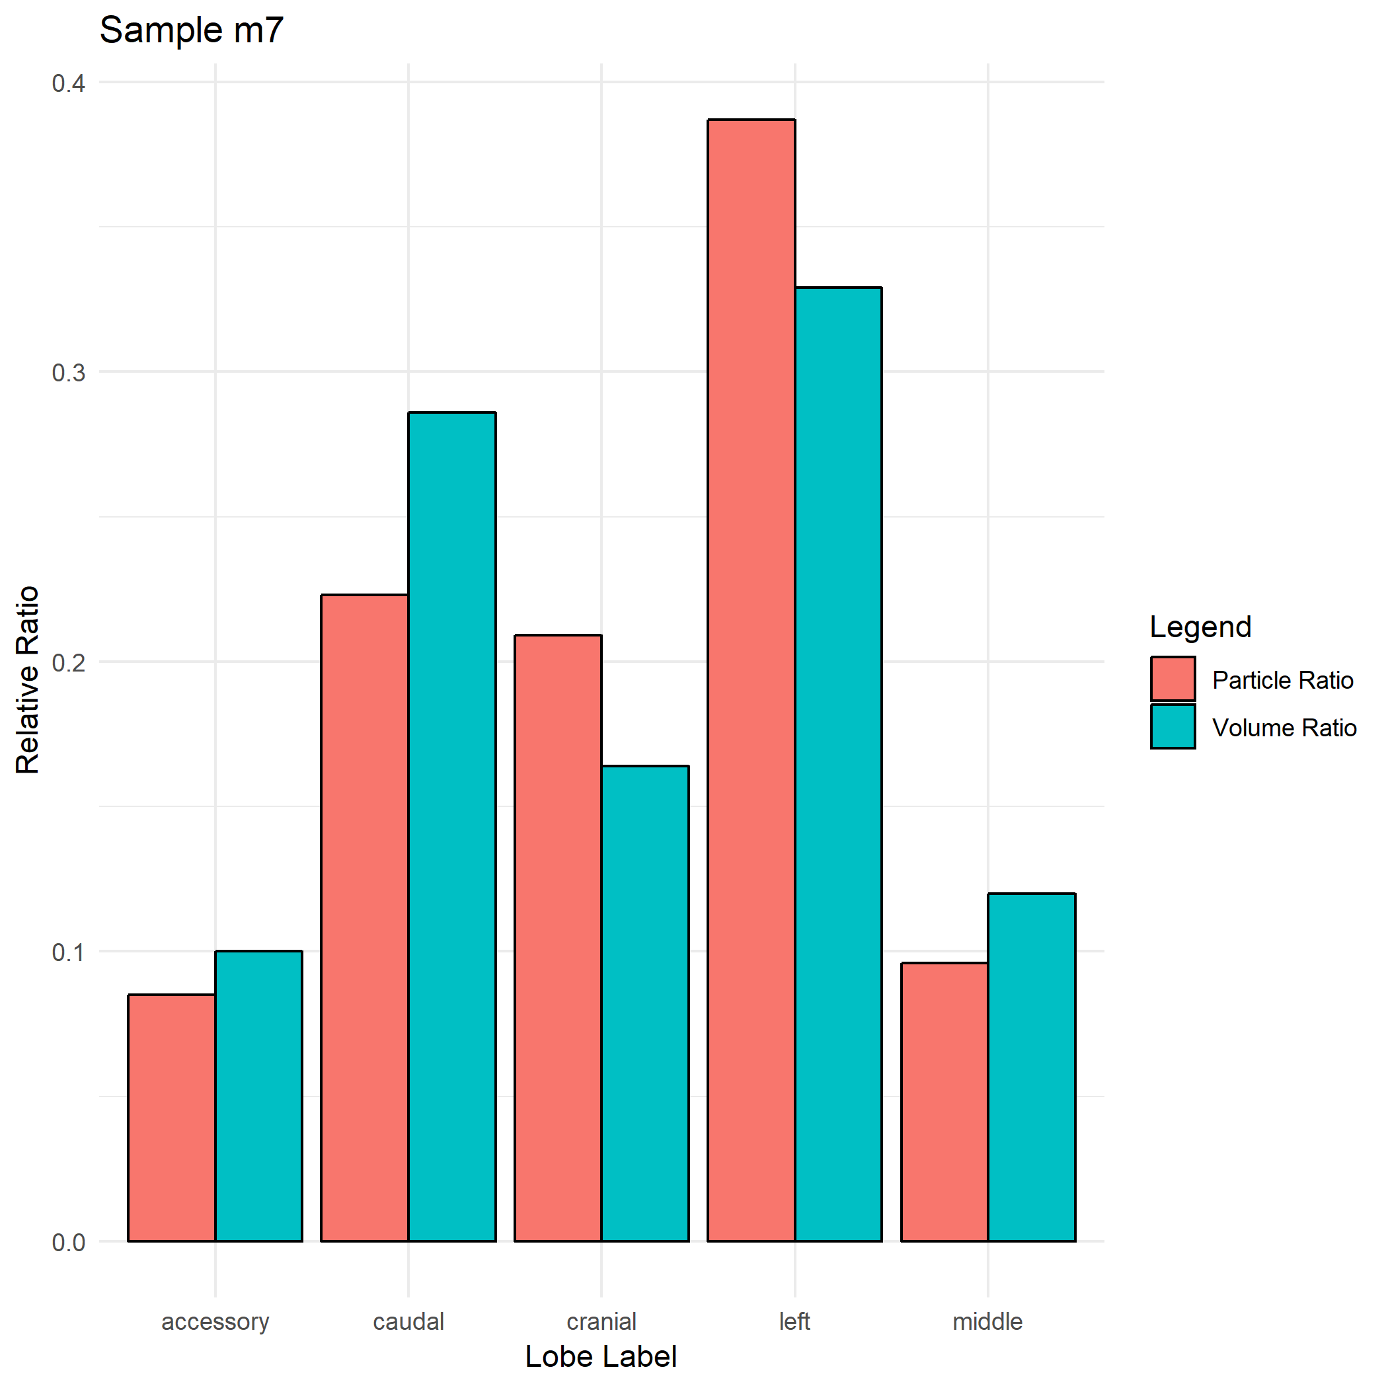
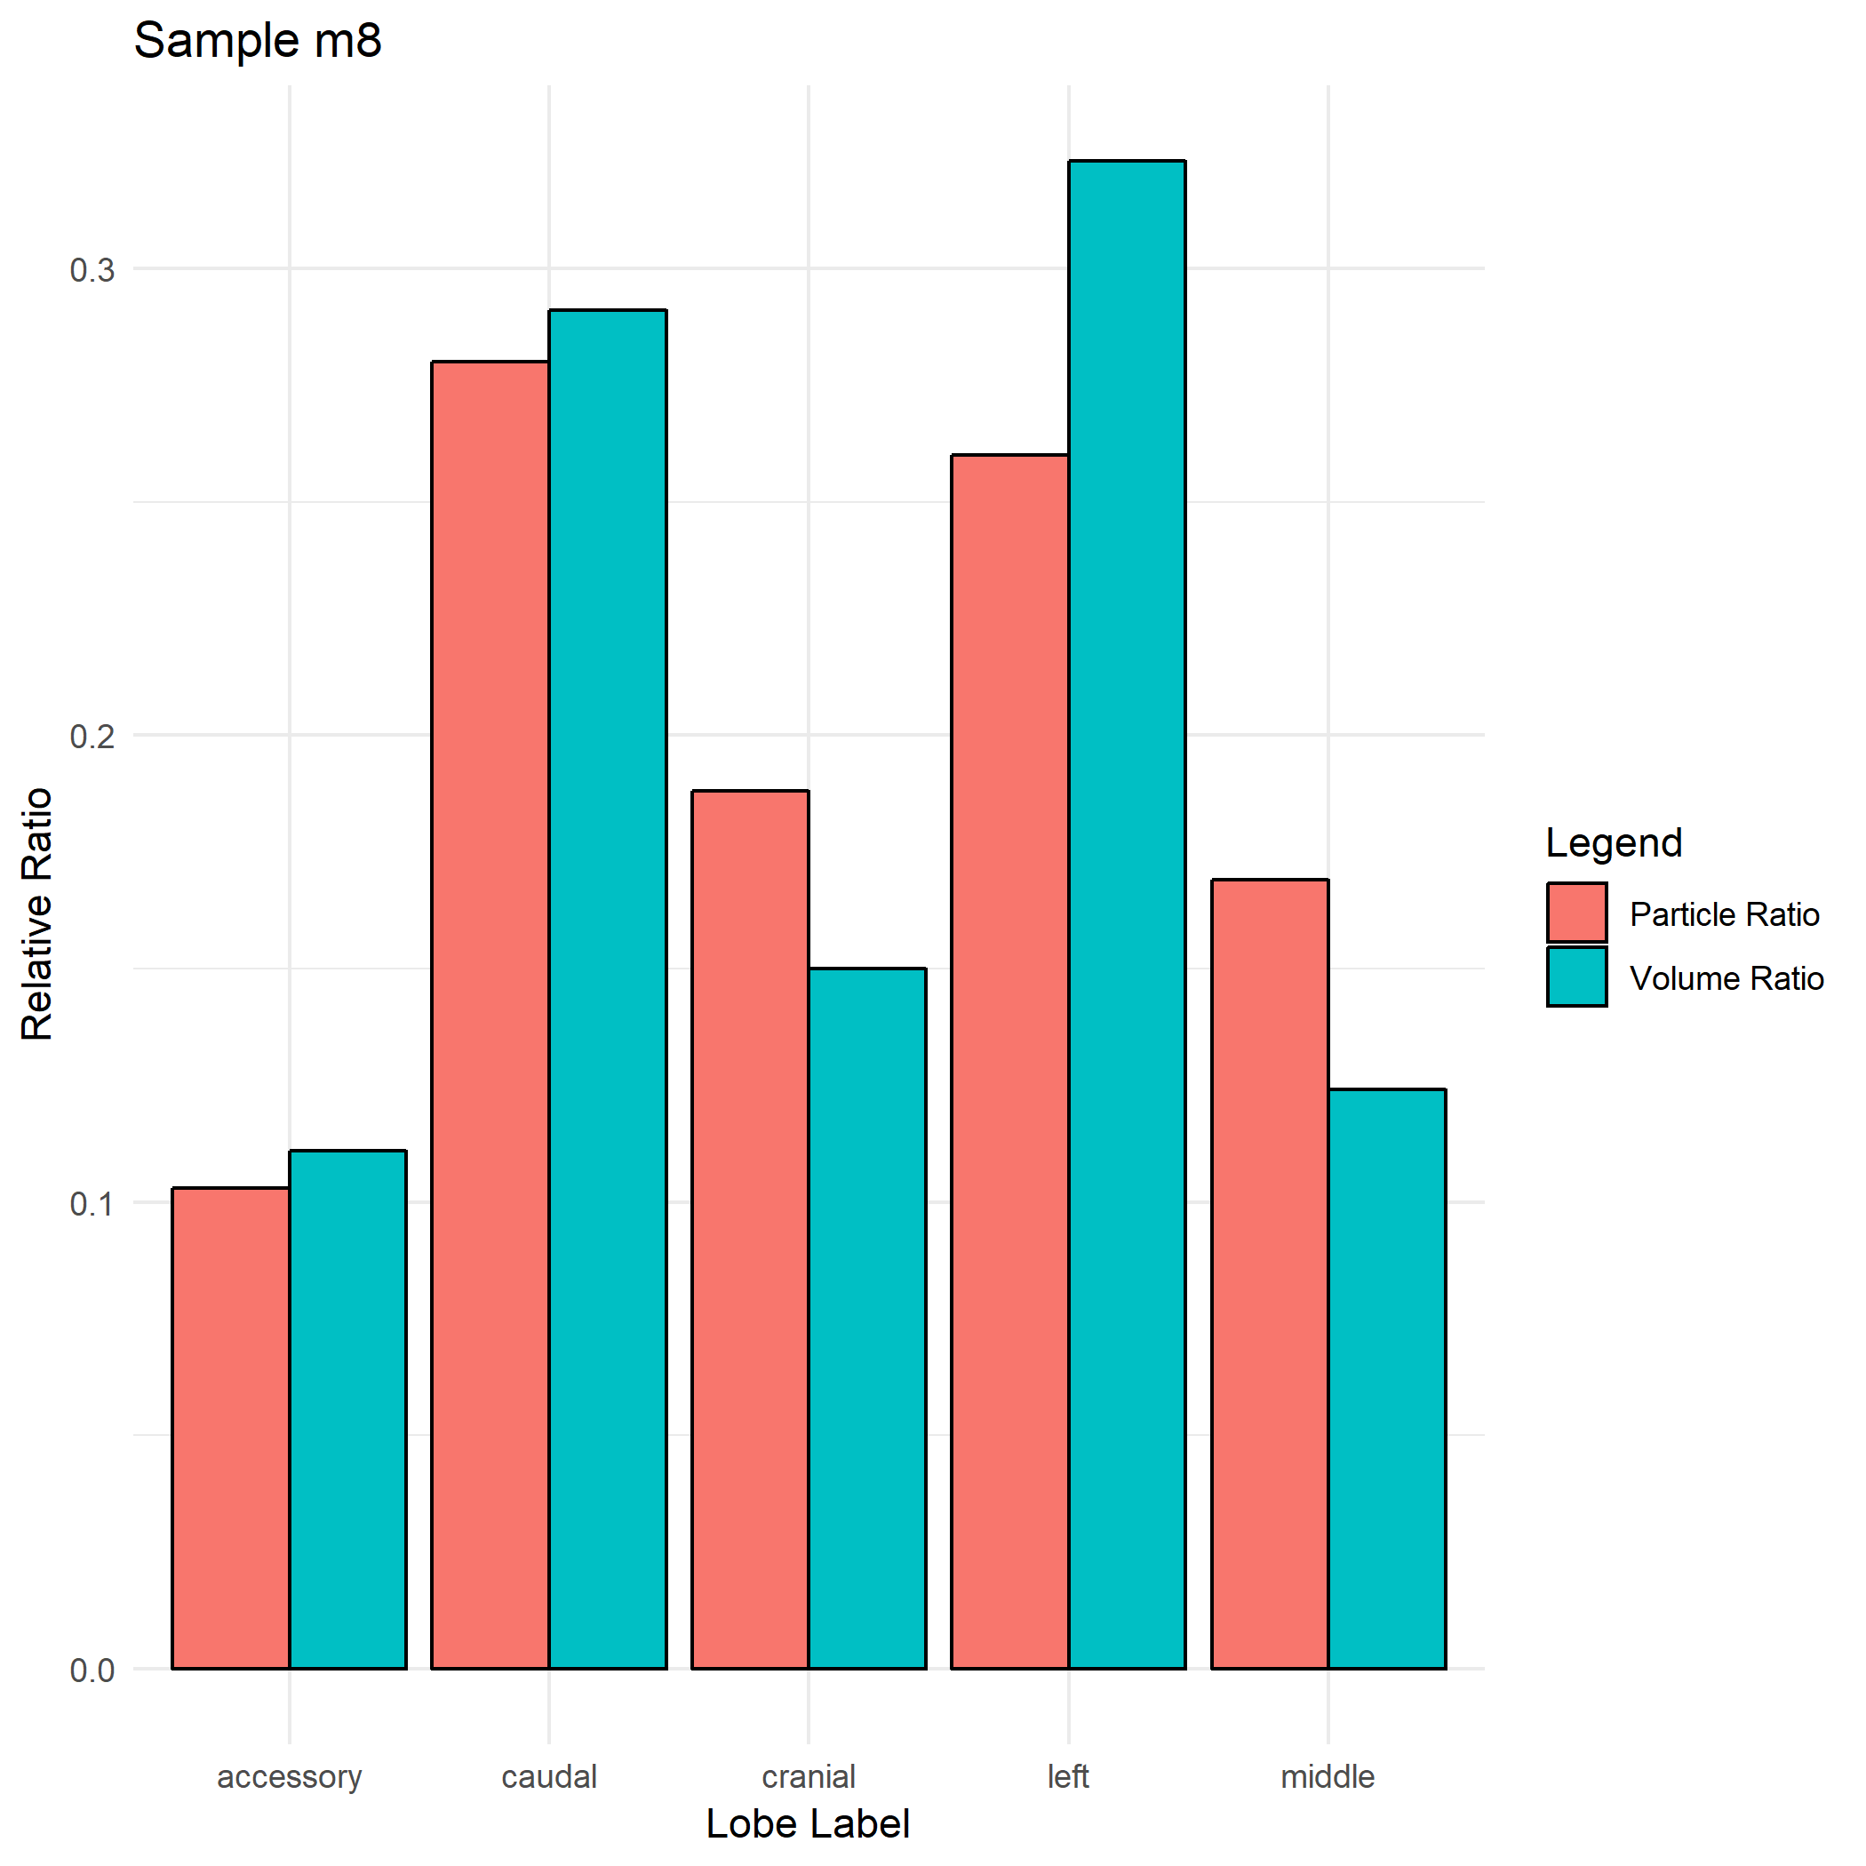
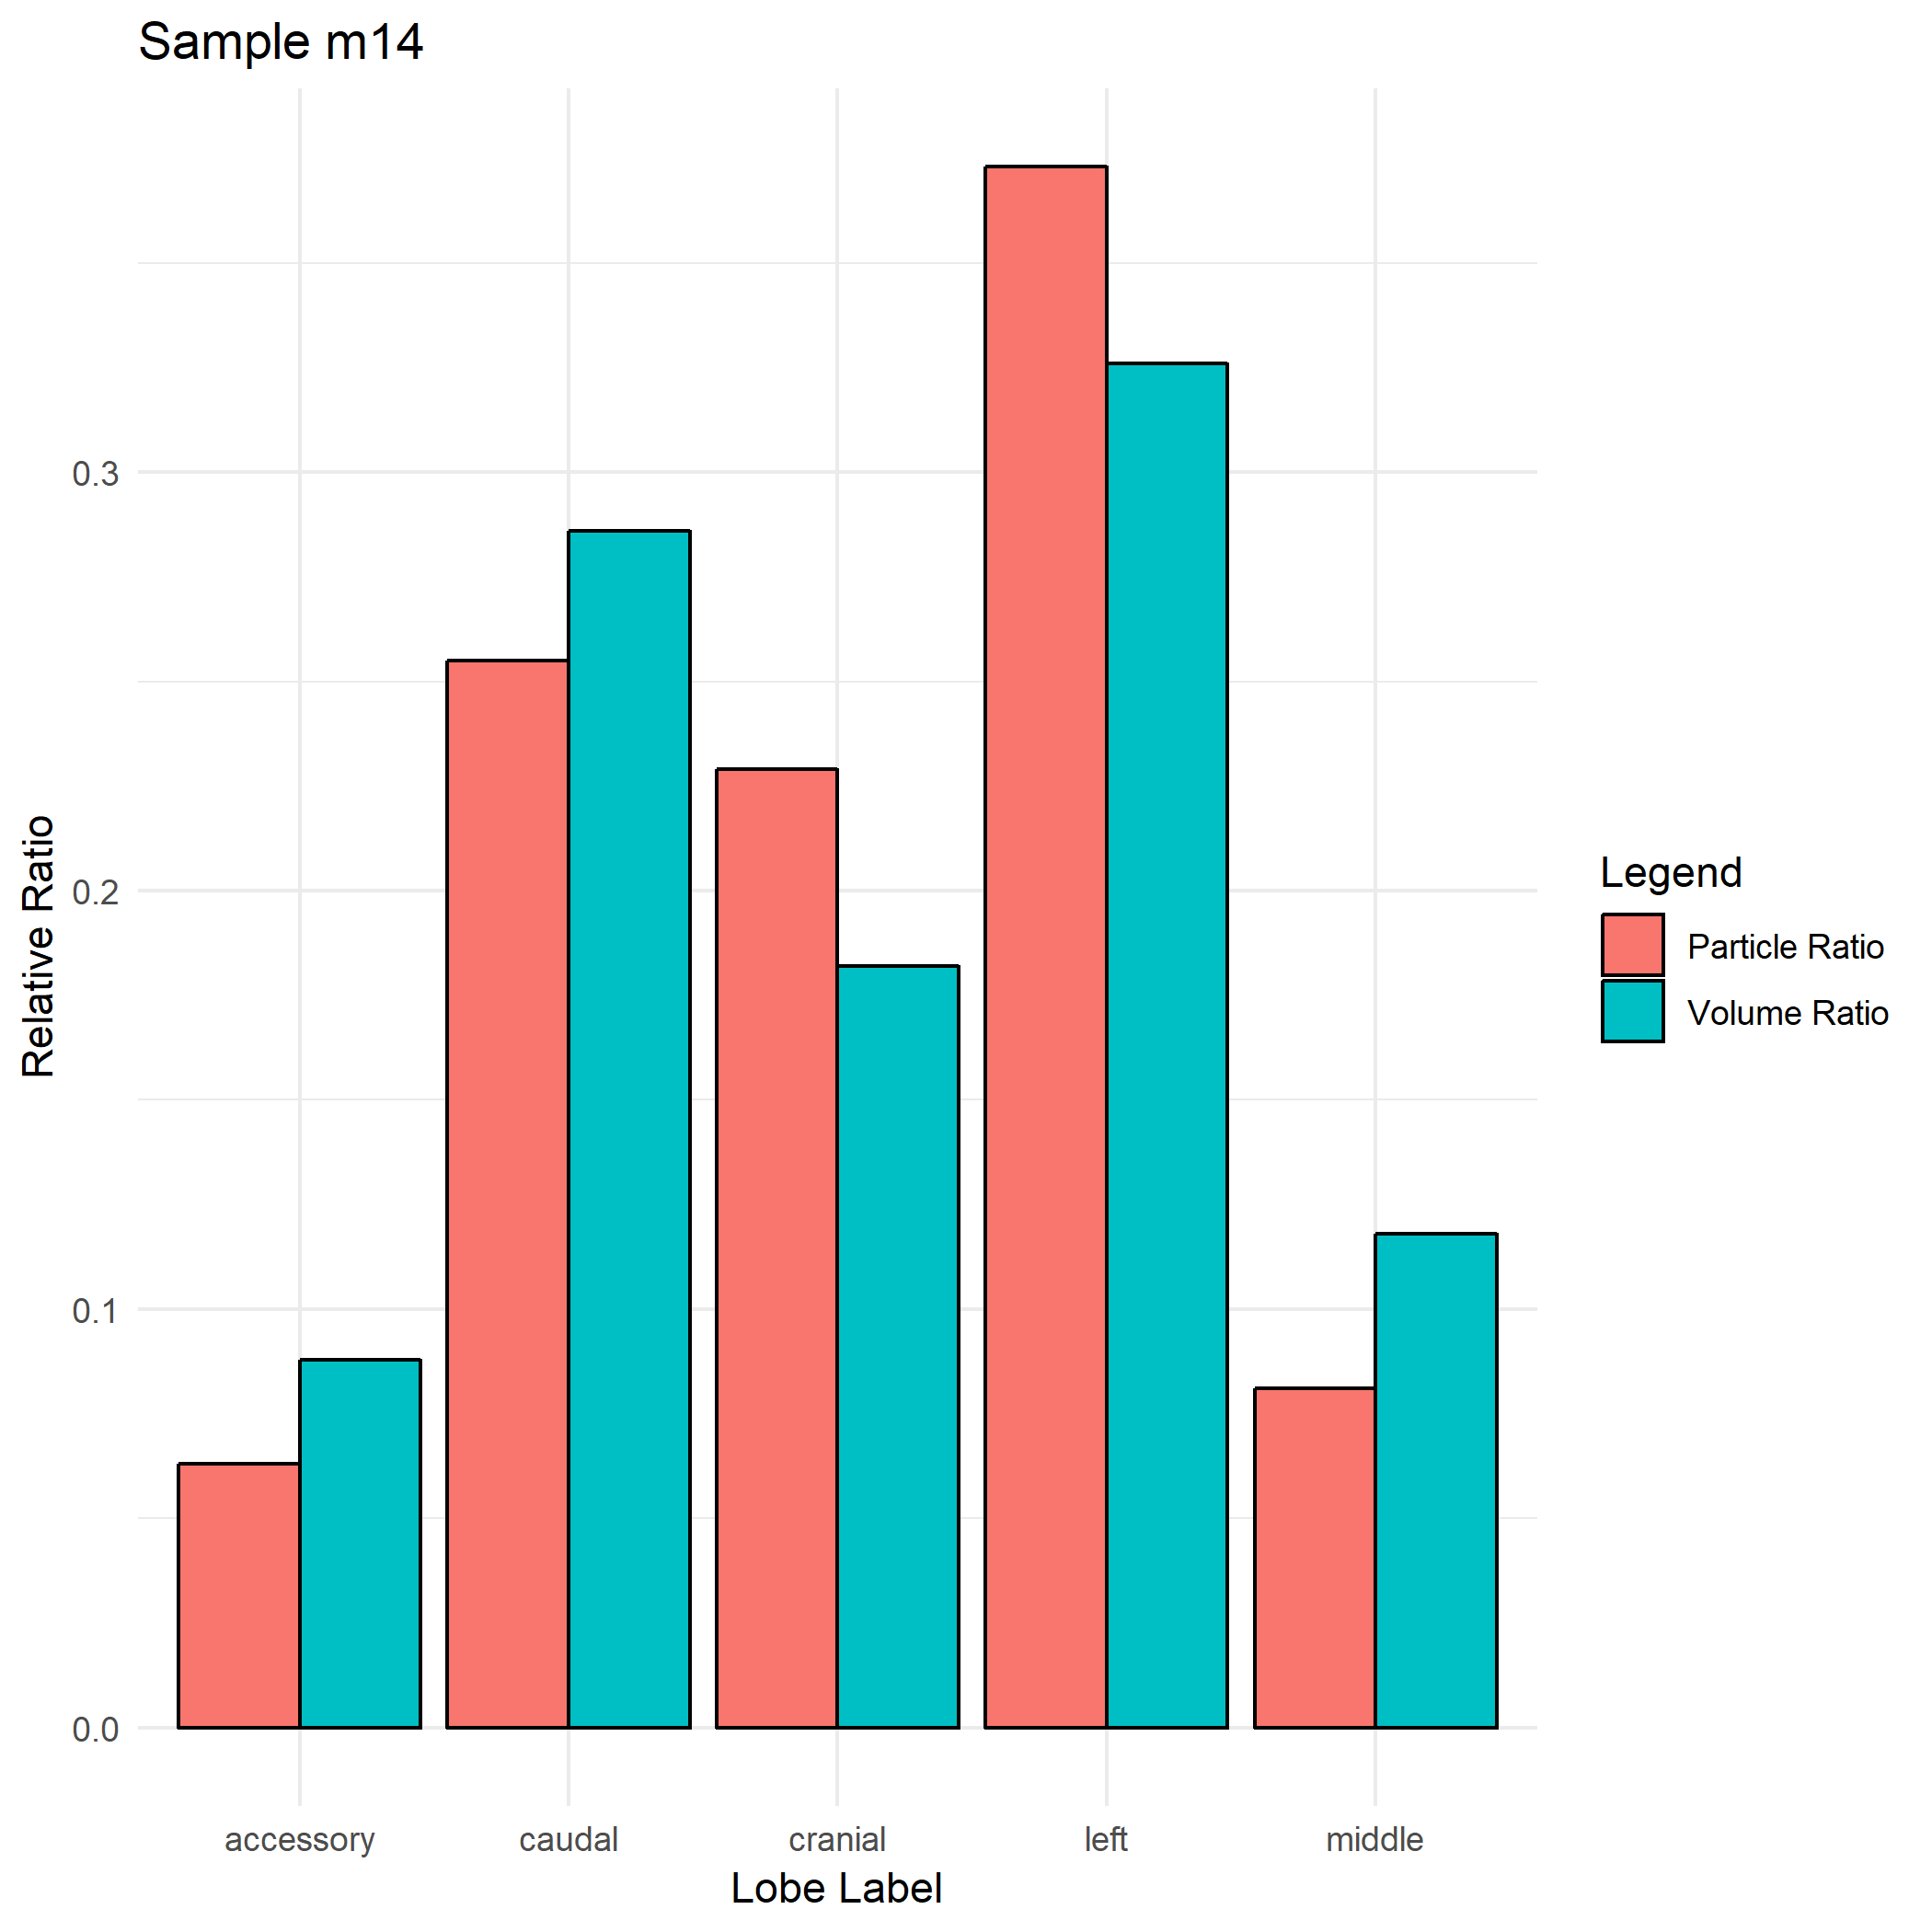

Slide 12
Strain CD-1
Name | Strain | Gender | Weight | Particle_Size
m12 | CD-1 | F | 24.5 | 1
m13 | CD-1 | F | 23.4 | 1
m04 | CD-1 | M | 24.4 | 1
m05 | CD-1 | M | N/A | 1

Slide 13
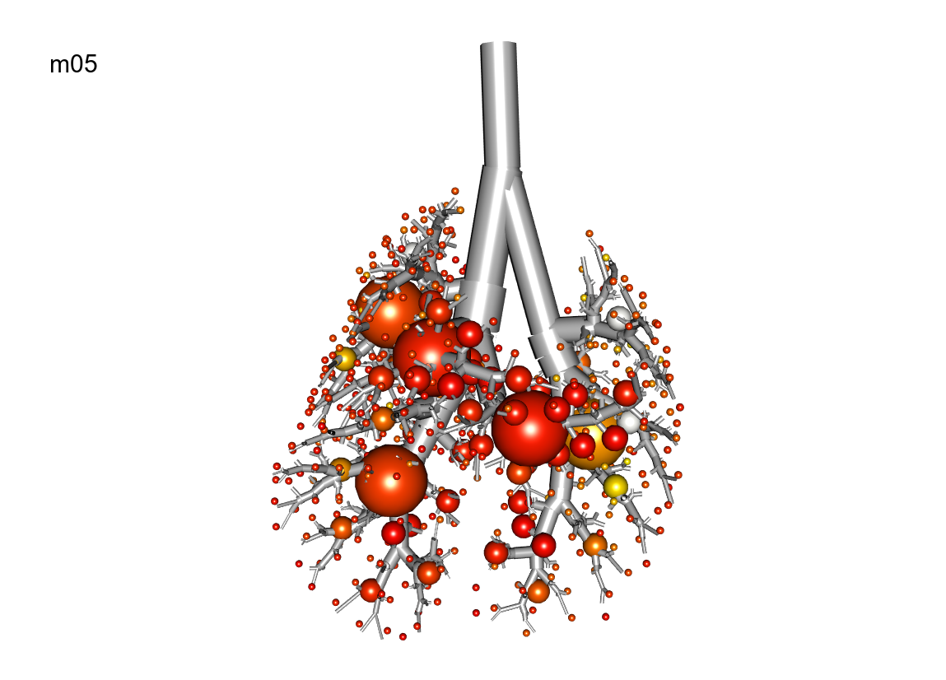
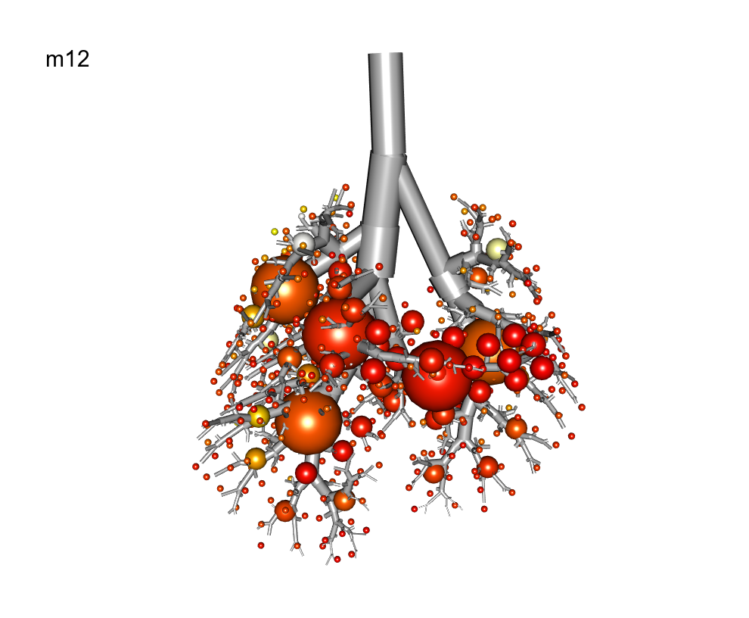
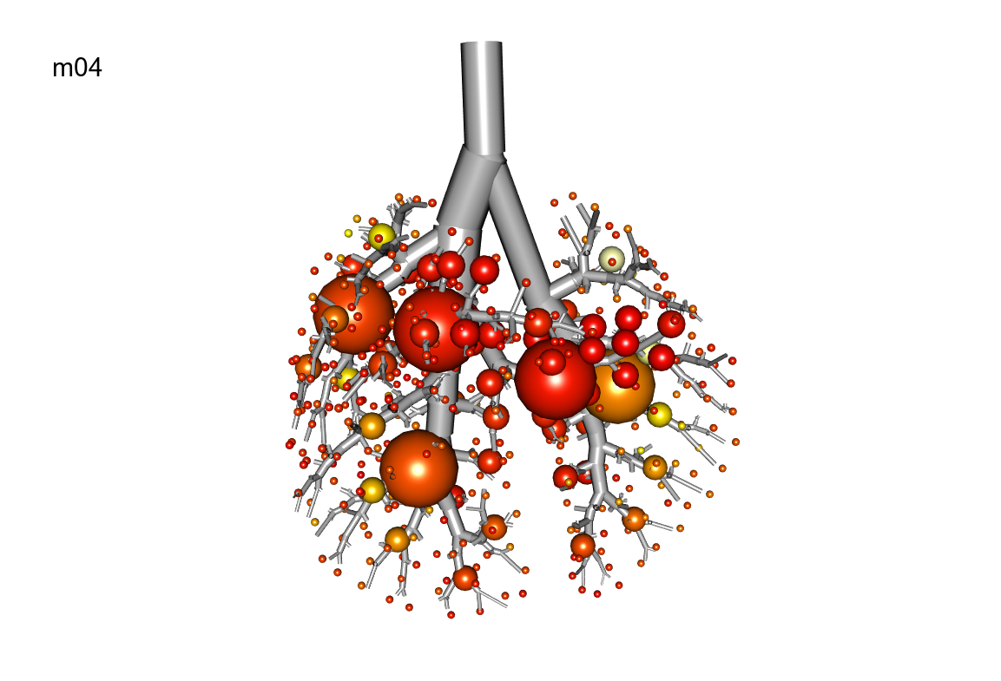
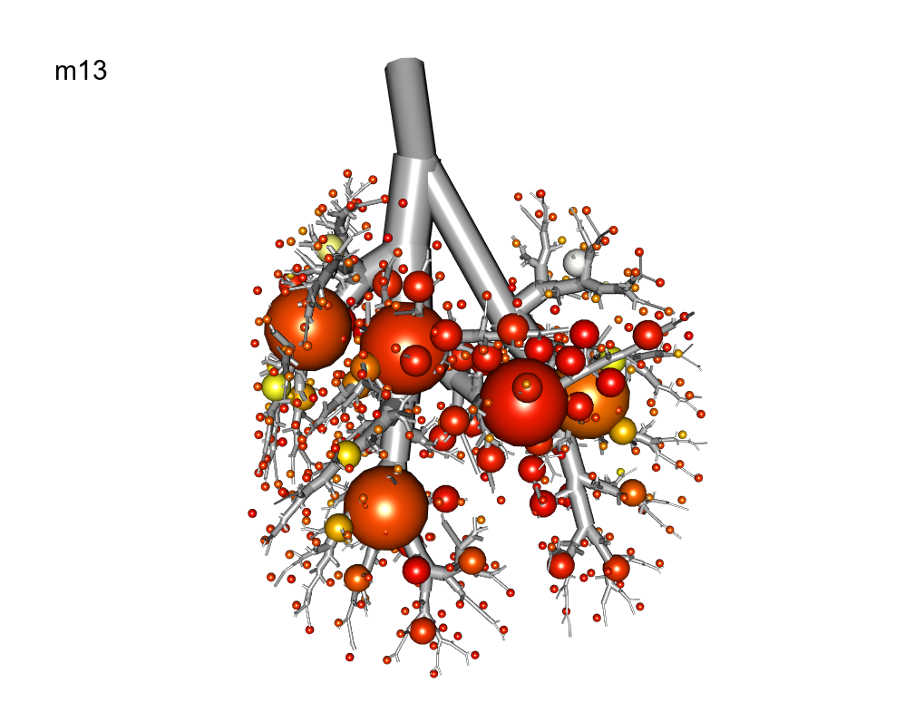

Slide 14
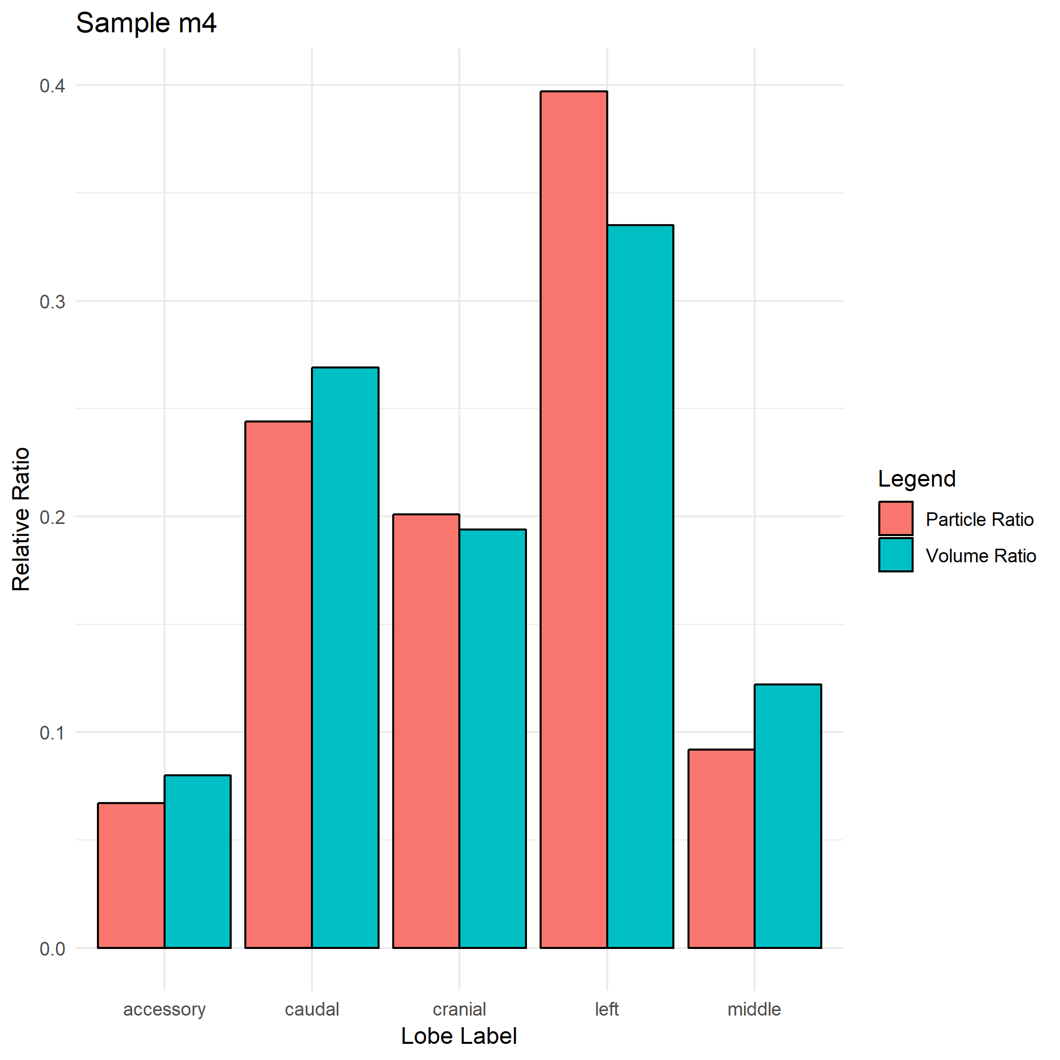
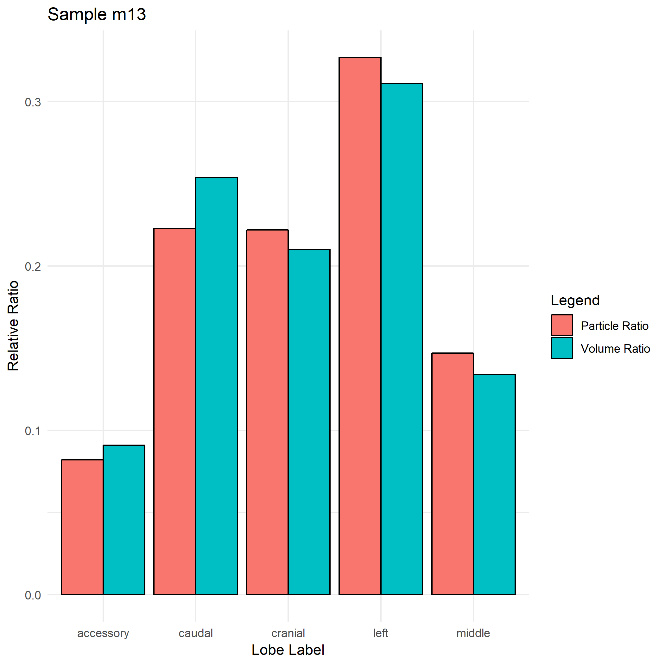
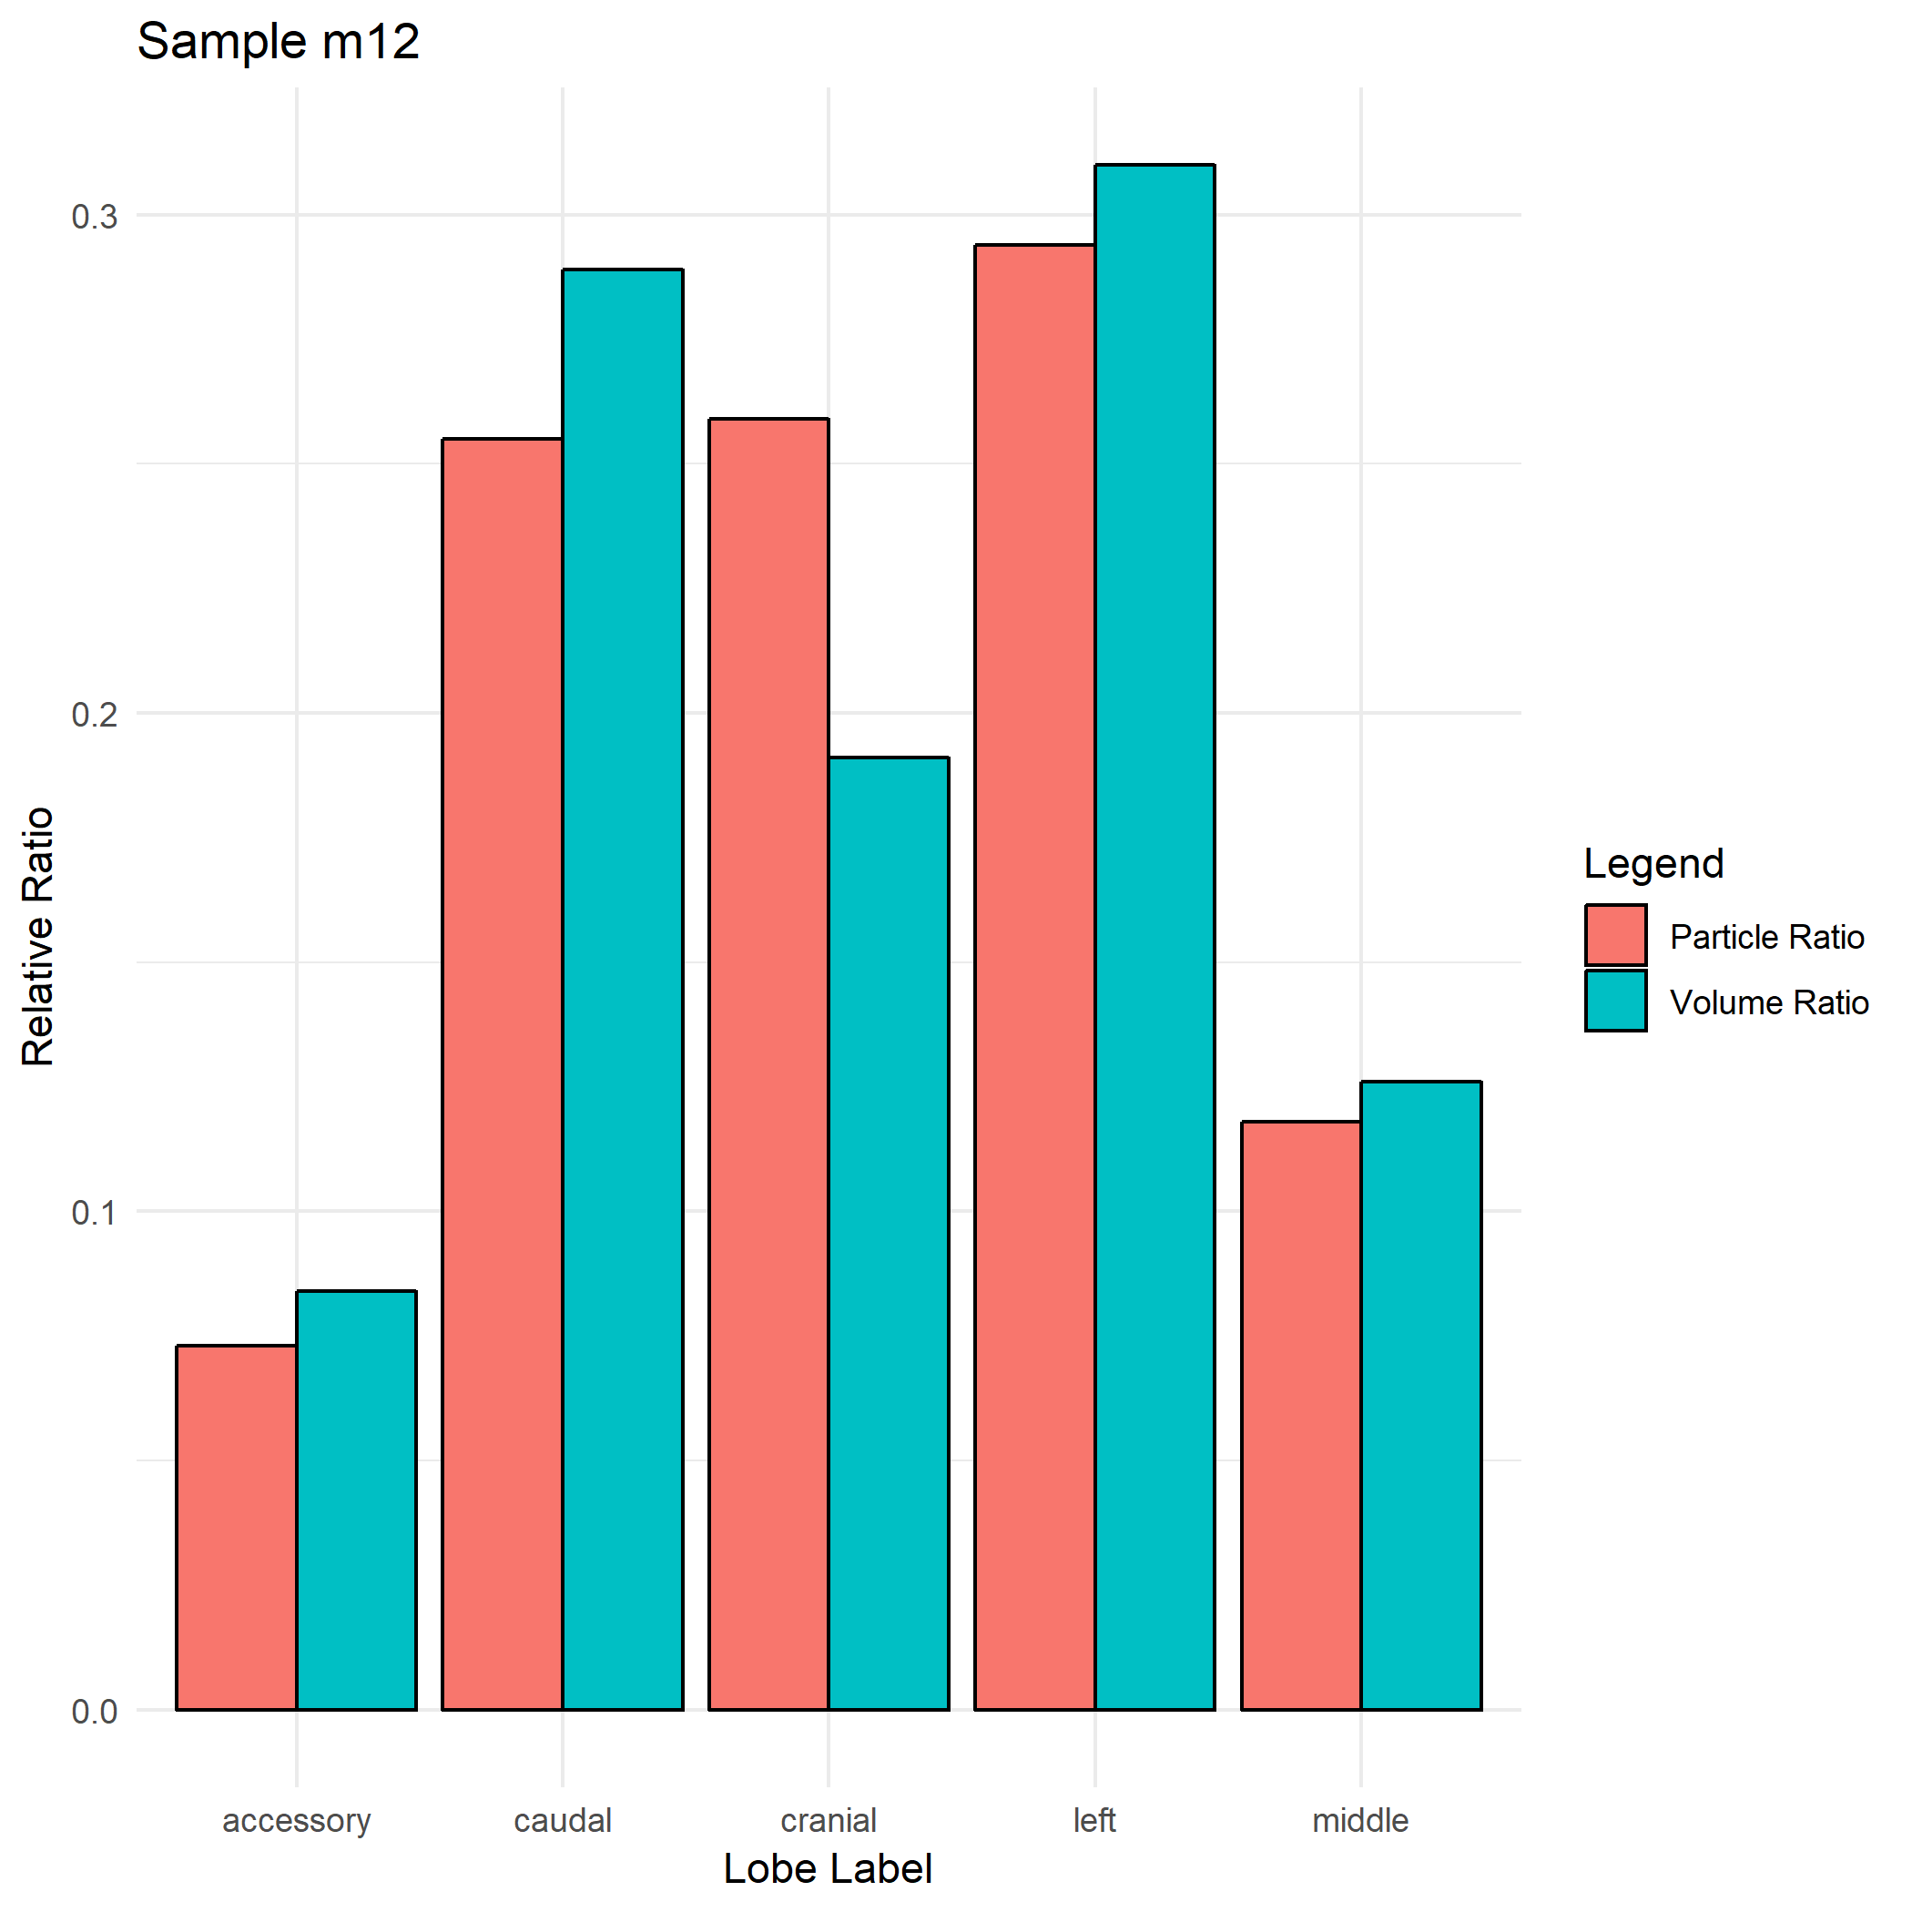
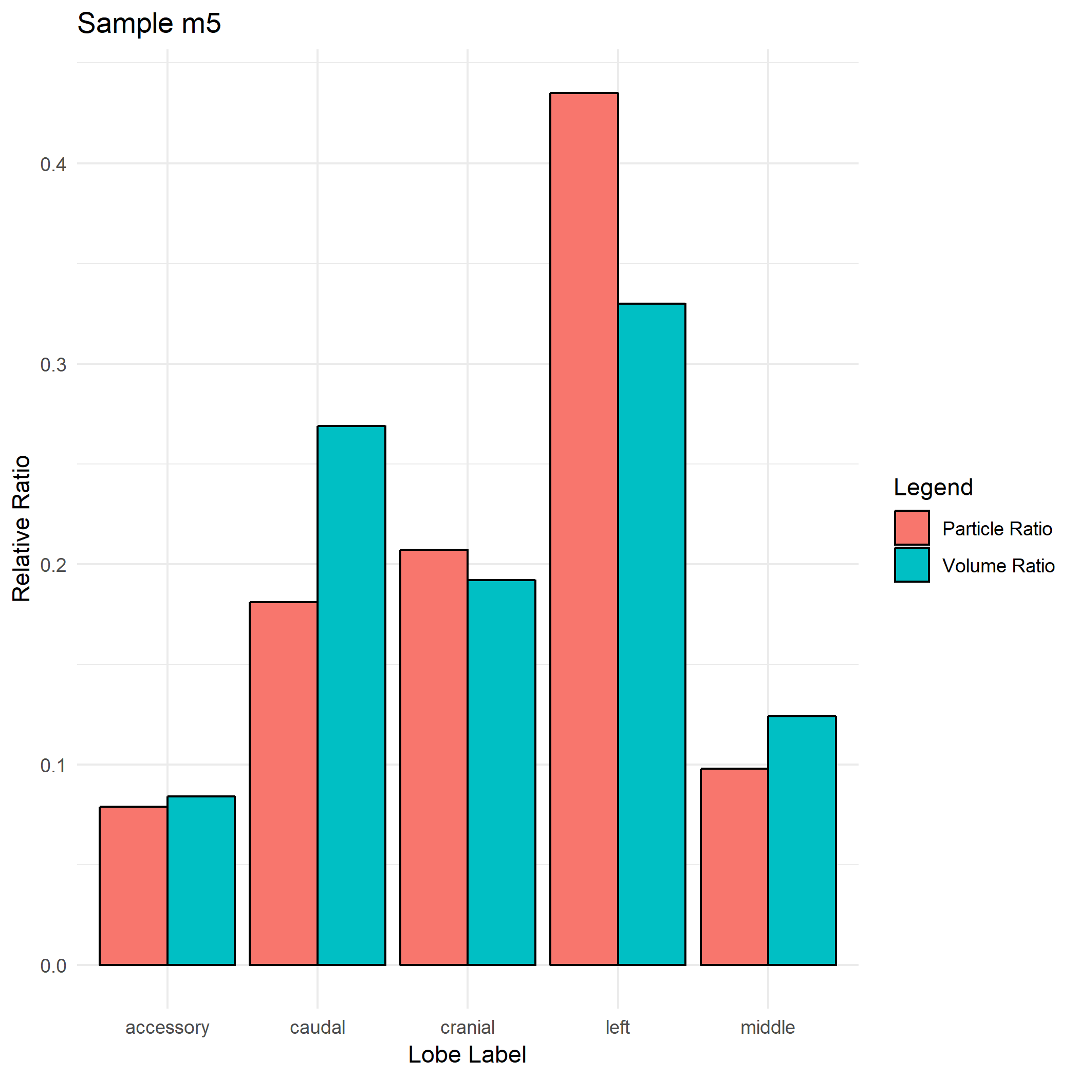

Slide 15
Particle size of 2 Microns
Name | Strain | Gender | Weight | Particle_Size
m15 | B6C3F1 | M | 23.8 | 2
m17 | C57BL/6 | F | NaN | 2
m16 | C57BL/6 | M | 22 | 2
m18 | CD-1 | F | 23.2 | 2

Slide 16
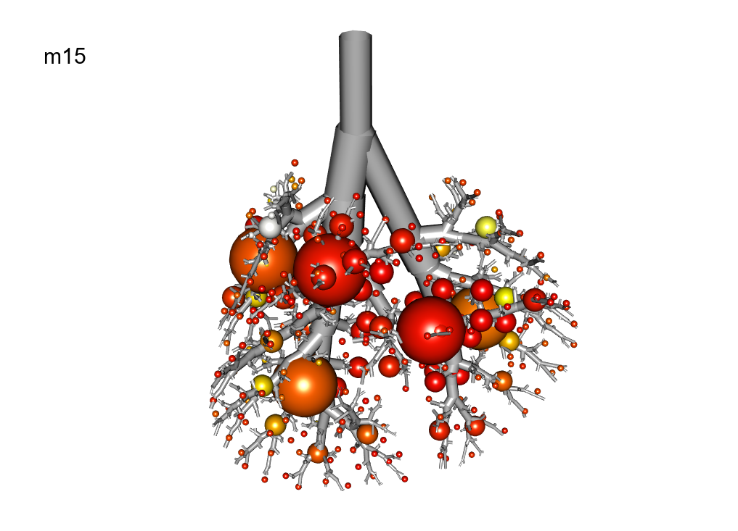
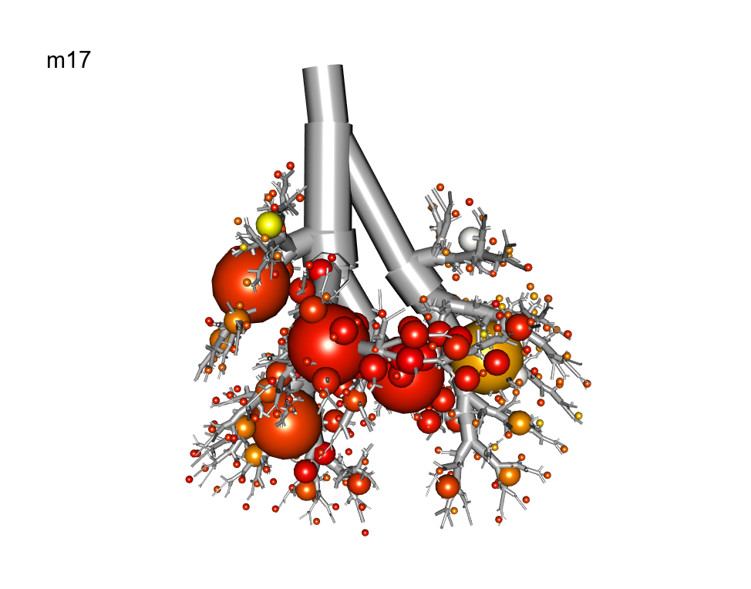
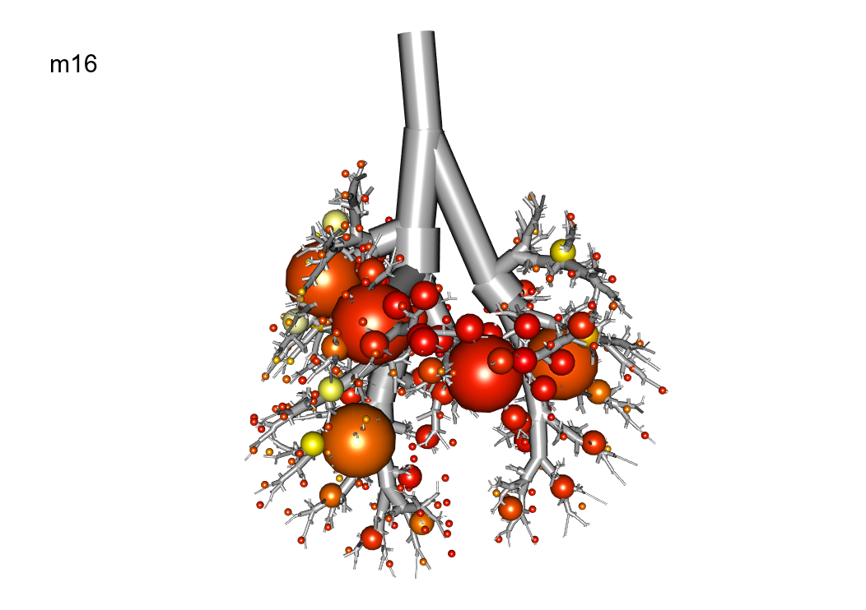
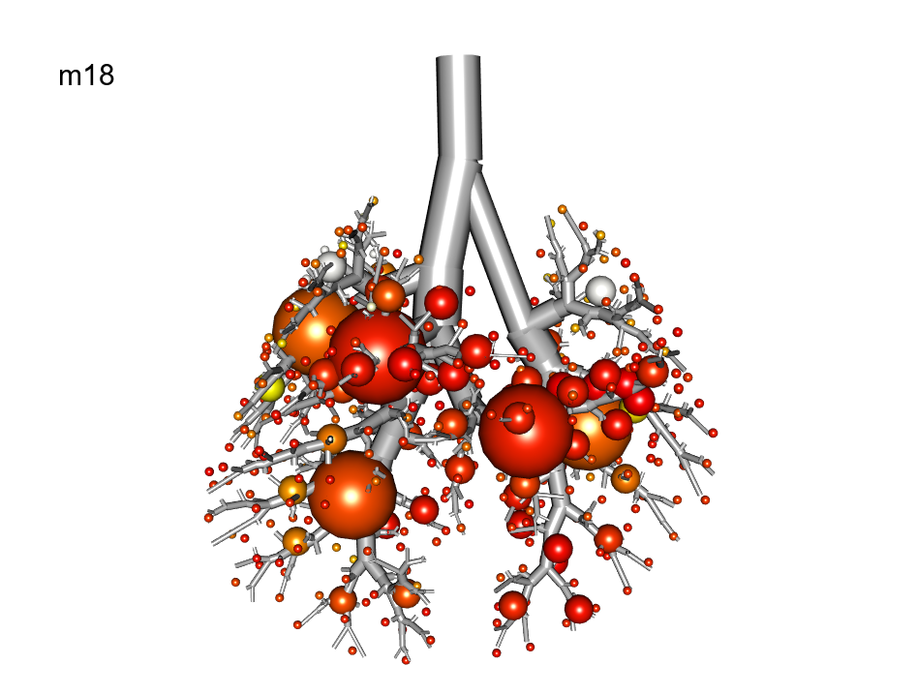

Slide 17
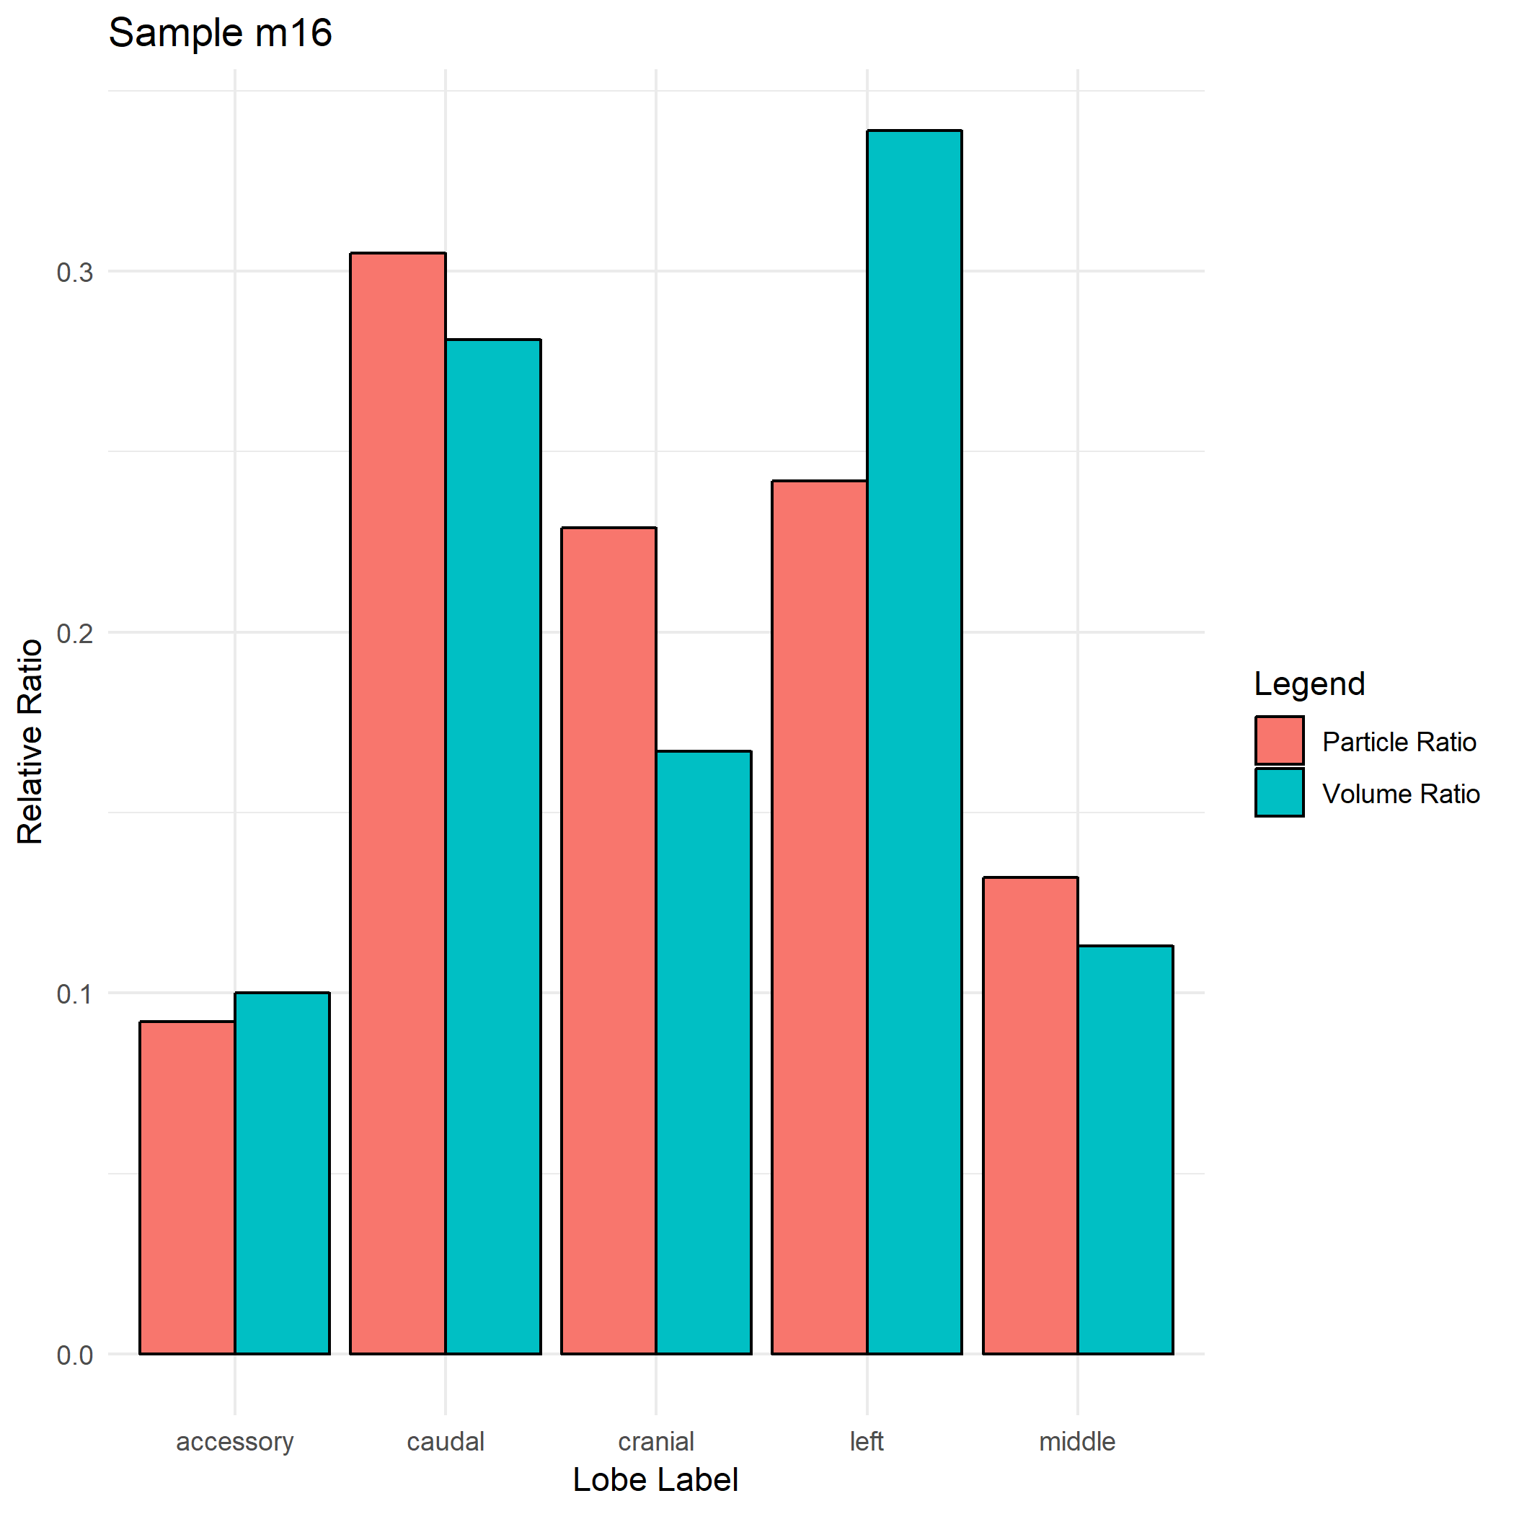
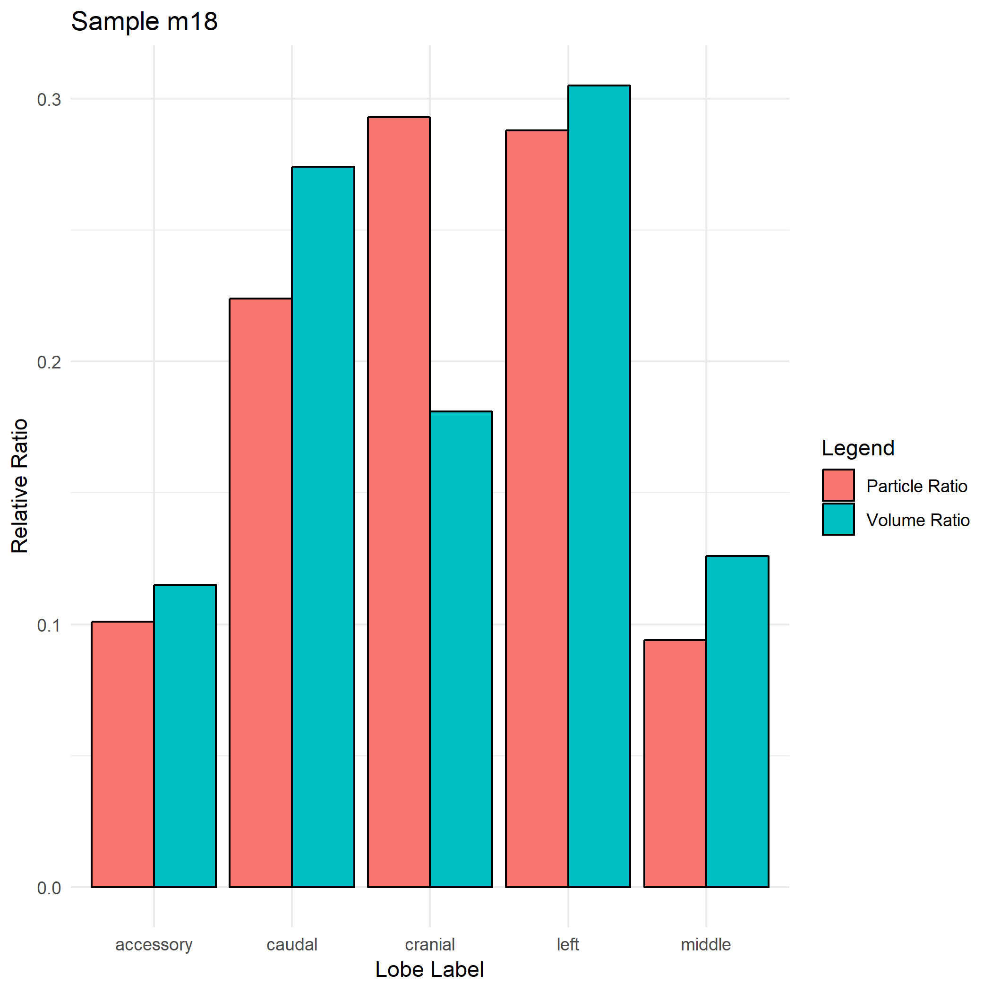
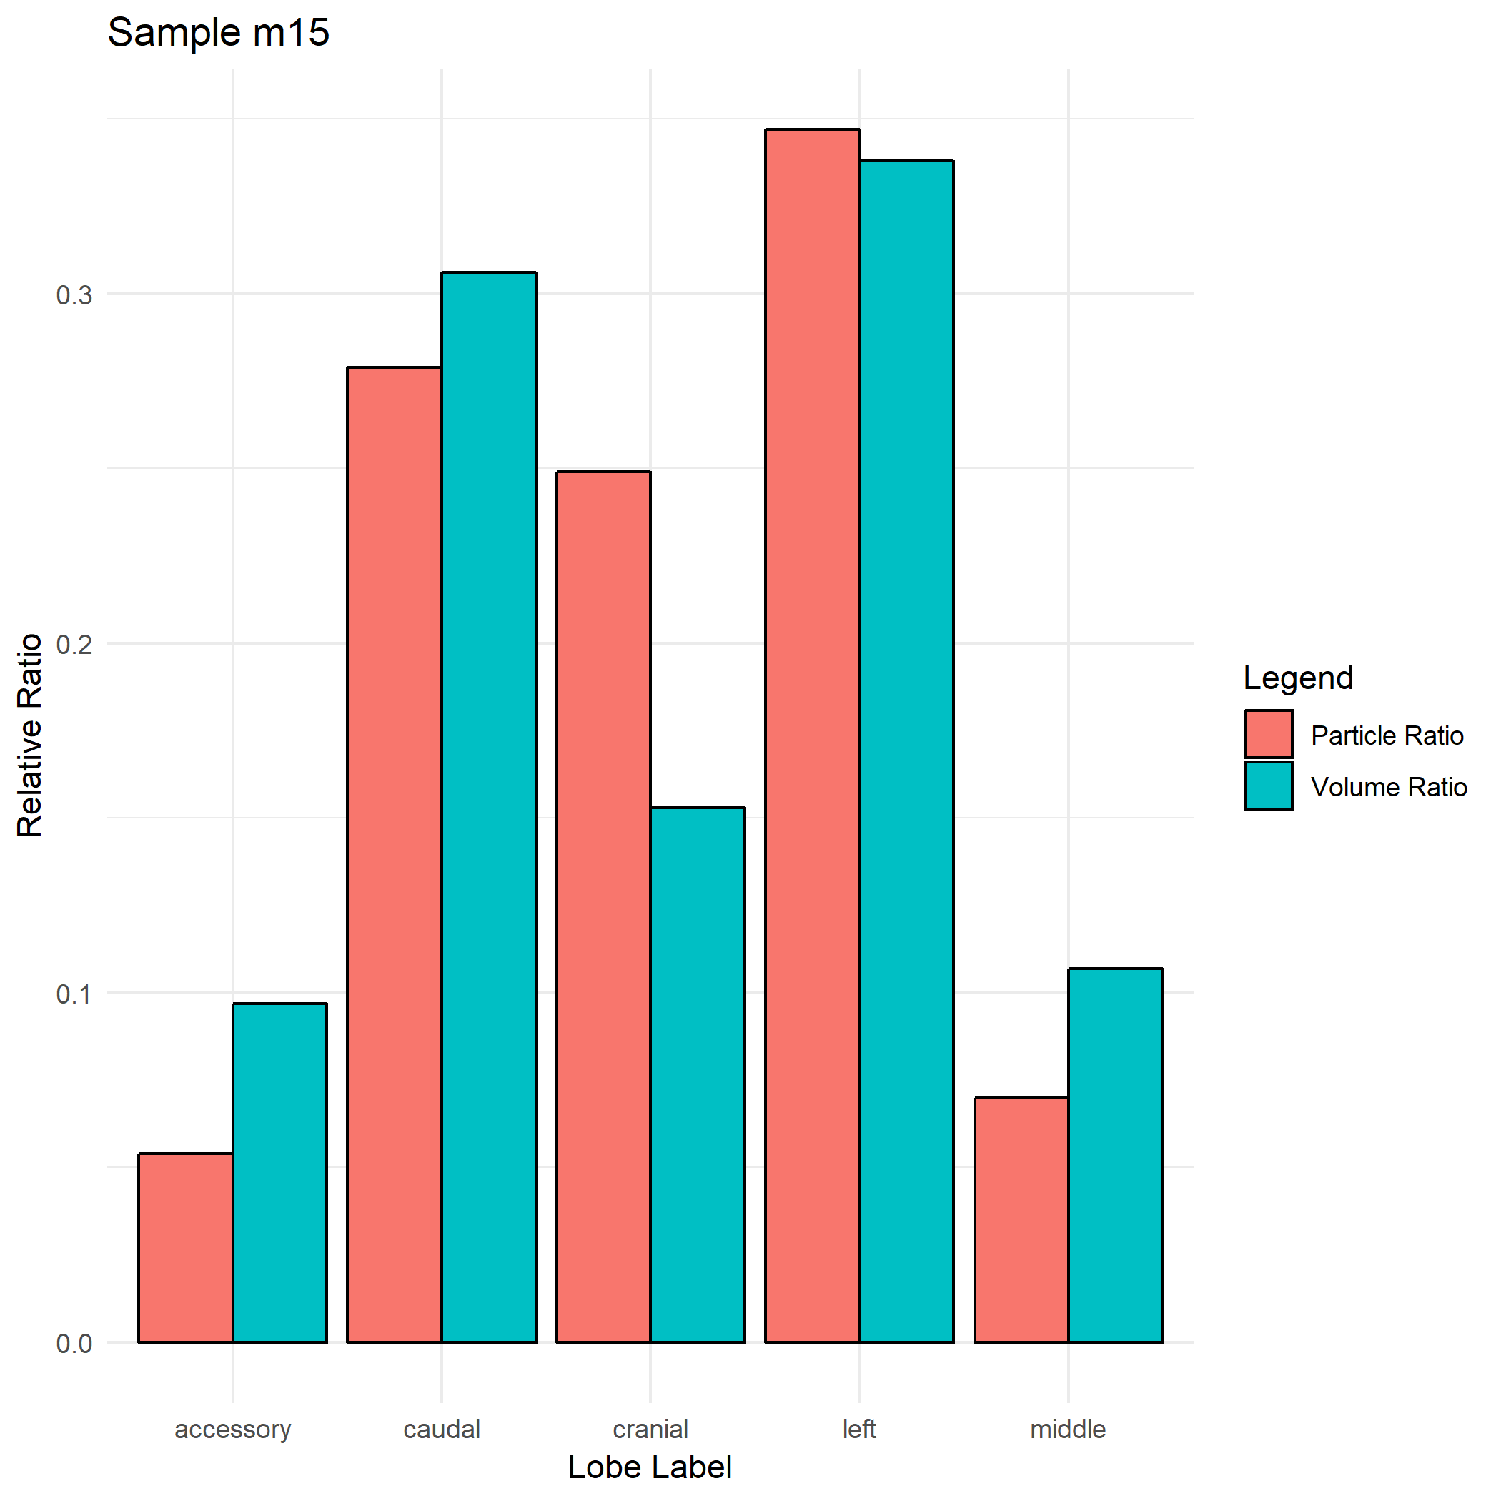
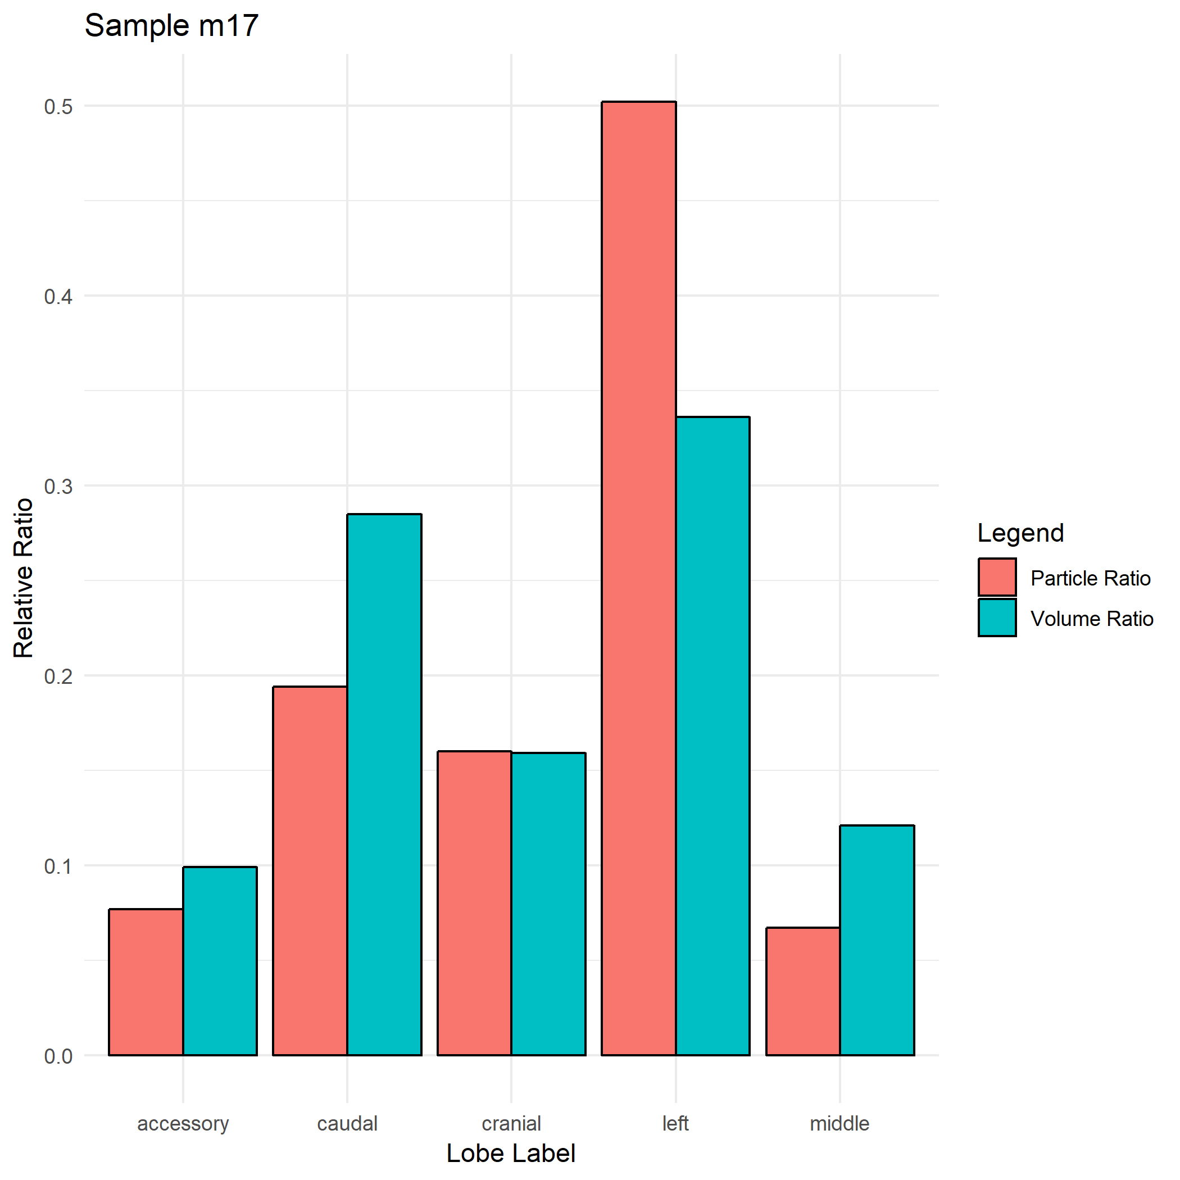

Slide 18
Strain C57Bl/6 with different particle size
Name | Strain | Gender | Weight | Particle_Size
m08 | C57BL/6 | F | 23 | 1
m07 | C57BL/6 | M | 24.1 | 1
m14 | C57Bl/6 | M | NaN | 1
m17 | C57BL/6 | F | NaN | 2
m16 | C57BL/6 | M | 22 | 2

